Slide 1
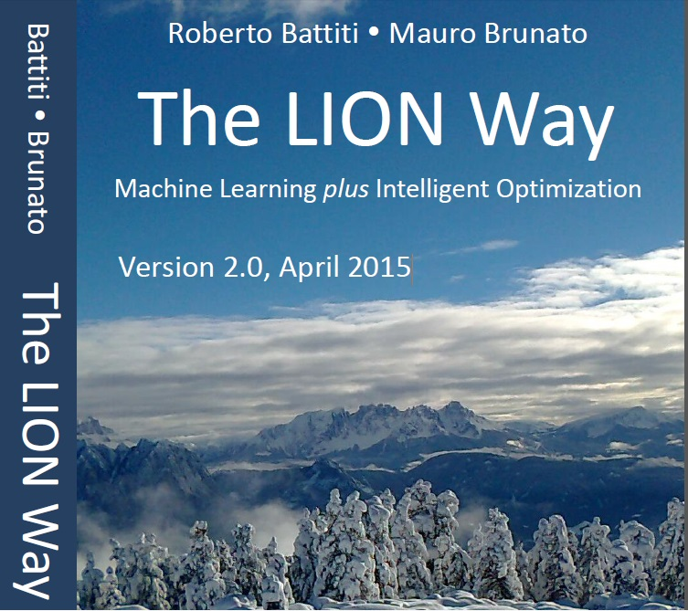
Roberto Battiti, Mauro Brunato.
The LION Way: Machine Learning plus Intelligent Optimization.
LIONlab, University of Trento, Italy,
Apr 2015
http://intelligent-optimization.org/LIONbook
© Roberto Battiti and Mauro Brunato , 2015,
all rights reserved.
Slides can be used and modified for classroom usage,
provided that the attribution (link to book website)
is kept.

Slide 2
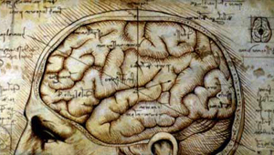
Chap. 9 Neural networks, shallow and deep
Quegli che pigliavano per altore altro che la natura, maestra de' maestri, s'affaticavano invano.
(Leonardo Da Vinci)

Slide 3
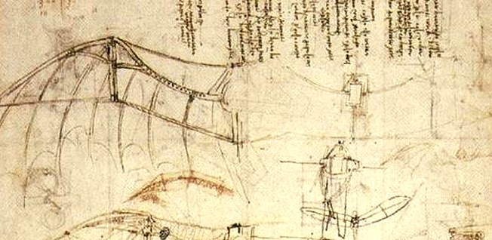

Slide 4
The biological metaphor
Our neural system is composed of 100 billion computing units (neurons) and 10¹⁵ connections (synapses).
How can a system composed of many simple interconnected units give rise to highly complex activities?
Emergence: complex systems arise out of a multiplicity of relatively simple interacting units.

Slide 5
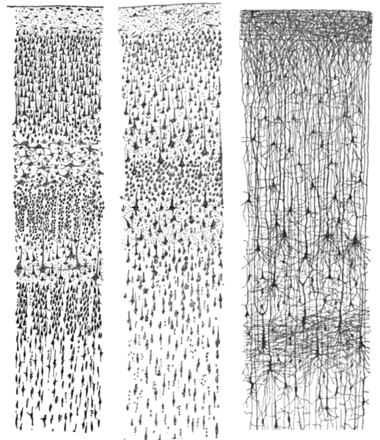
Drawings of cortical lamination by Santiago Ramon y Cajal, each showing a vertical cross-section, with the surface of the cortex at the top. The different stains show the cell bodies of neurons and the dendrites and axons of a random subset of neurons.

Slide 6
Symbolic vs. sub-symbolic paradigm
”Standard” sequential computers operate in cycles, fetching items from memory, applying mathematical operations and writing results back to memory.
The intelligence of biological brains is different, it lies in the interconnection strengths, learning occurs by modifying connections (dynamical systems)
Neural networks do not separate memory and processing but operate via the flow of signals through the network connections.

Slide 7
Artificial Neural Networks
A neuron is modeled as a simple computing unit, a scalar product w x (“pattern matching”) followed by a sigmoidal (“logistic”) function.
The complexity comes from having more interconnected layers of neurons involved in a complex action (if linear layers are cascaded, the system remains linear)
The ”squashing” functions is essential to introduce nonlinearities in the system

Slide 8
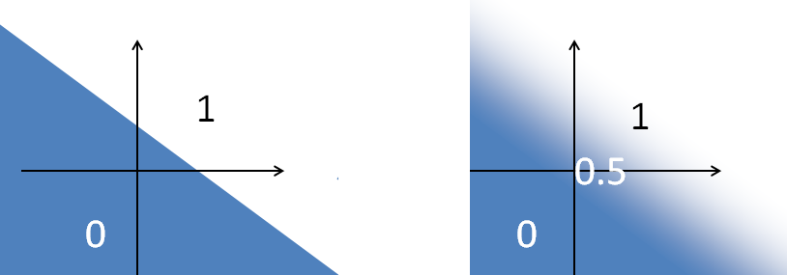
Multilayer Perceptrons (MLP)
By applying a sigmoidal transfer function to the unlimited output of a linear model, one obtains an output in [0,1] which can be interpreted as a probability
For classification, hyperplane boundaries become “fuzzy”

Slide 9
Multilayer Perceptrons (MLP)(2)
Composing linear transformations → still linear functions.
Composing linear functions with nonlinear sigmoids one can approximate all smooth functions. One hidden layer is sufficient.
The first linear transformation provides a first ”hidden layer” of outputs, the second transformation produces the visible outputs from the hidden layer.

Slide 10
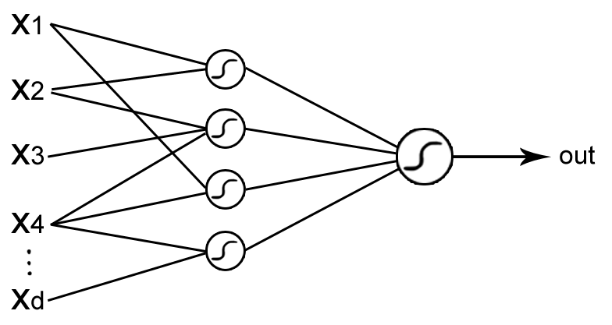
MLP architecture
MLPs are composed of a large number of interconnected units working in parallel and organized in layers with a feedforward information flow.

Slide 11

MLP architecture (2)
The signals flow sequentially from the input to the output layer.
For each layer, each unit does the following:
scalar product between a vector of weights and the vector of outputs of the previous layer;
nonlinear function to each result to produce the input for the next layer
A popular transfer function is the
sigmoidal (or “logistic”) function

Slide 12
MLPs are universal approximators
What is the flexibility of the MLP architecture to represent input-output mappings?
An MLP with one hidden layer and a sufficient number of hidden nodes can approximate any smooth function to any desired accuracy.
MLPs are very flexible models: they can approximate any smooth input-output transformation.

Slide 13
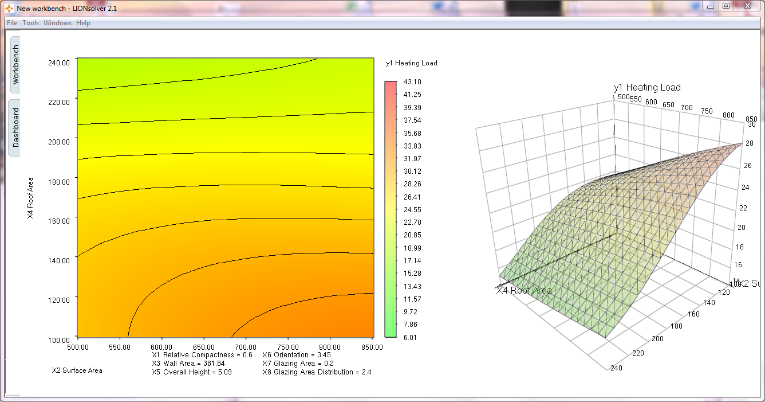
Analyzing a neural network output with LIONoso Sweeper. The output
value, the energy consumed to heat a house in winter, is shown as a function of input parameters. Color coded output (left), surface plot (right). Nonlinearities are visible.

Slide 14
Error Backpropagation
How do we learn optimal MLPs from examples?
take a ”guiding” function to be optimized (e.g., sum-of-squared errors on the training examples)
Use gradient descent with respect to the weights to find the better and better weights
Stop the descent when results on a validation set are best (if over-learning, generalization can worsen). Learning is not an end, but a means for generalizing.

Slide 15
Backpropagation(2)
One needs derivatives, a simple analysis exercise.
MLP is a composition of squash functions and scalar products.
Derivatives can be calculated by using the chain rule for derivatives of composite functions.
Complexity is O(number of weights).
Formulas are similar to those used for the forward pass, but going in contrary direction, hence the term error backpropagation.
After the network is trained, calculating the output from the inputs requires a number of simple operations proportional to the number of weights.

Slide 16

Batch backpropagation
Given an MLP, define its sum-of-squared-differences energy as:
Let the initial weights be randomly distributed
Calculate the gradient
The weights at the next iteration k + 1 are updated as follows
Partial derivatives

Slide 17

Bold-Driver Backpropagation
How do we select the learning rate ε ? If small, the learning time increases, if big, the energy oscillates wildly.
If successive steps reduce E(w), ε increases exponentially
If E(w) increases, ε decreases rapidly
ρ is close to one (1.1) in order to avoid frequent ”accidents” σ is chosen to provide a rapid reduction( 0.5), and l is the minimum integer such that the reduced rate succeeds in diminishing the energy

Slide 18
On-line or stochastic backpropagation
E is a sum of many terms, one for each pattern p
The gradient is a sum of the corresponding partial gradients
In “batch” gradient descent, first the contributions are summed, then the small step is taken
Stochastic BP: randomly choose a pattern p and take a small step along a single negative immediately after calculating it.

Slide 19

On-line or stochastic backpropagation (2)
Stochastic on-line backpropagation update:
where the pattern p is chosen randomly from the training set at each iteration and ε is the learning rate
Pros: using partial gradients is faster
Cons: less guarantee of convergence

Slide 20
Advanced optimization for MLP training
Higher-order derivatives can be used to enhance the search.
Conjugate gradient and secant methods update an approximation of the Hessian by using only gradient information.
They are useful for problems with few weights (approx < 100) and requiring high precision in the output value.

Slide 21
Deep neural networks
Some classes of input-output mappings are easier to build if more hidden layers are considered.
The dream: feed examples to an MLP with many hidden layers and have the MLP automatically develop internal representations (encoded in the activation patterns of the hidden-layers).

Slide 22
Practical obstacles to deep MLPs
Partial derivatives w.r.t. the weights of the first layers tend to be very small, leading to numerical estimation problems.
As a result, it can happen that the internal representations developed by the first layers will not differ too much from being randomly generated, and leaving only the topmost levels to do some ”useful” work.
A very large number of parameters (such as in deep MLP) can lead to overtraining

Slide 23
Applications of deep learning
Lately, deep learning has lead to superior classification results in challenging areas
The main scheme is as follows:
1. use unsupervised learning from many unlabeled examples to prepare the deep network in an initial state;
2. use back propagation only for the final tuning with the set of labeled examples

Slide 24
Auto-encoders
Auto-encoders build internal representations in an unsupervised manner
One builds a network with a hidden layer and demands that the output simply reproduces the input
Squeezing: in the hidden layer the input is compressed into an encoding c(x) with less variables than the original one
c(x) will be forced to discover regularities in the input patterns

Slide 25
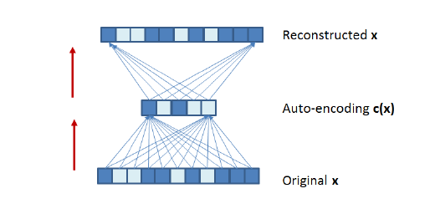
Auto-encoders (2)

Slide 26
Auto-encoders (3)
The auto-encoder can be trained by backpropagation
Classification labels are not necessary
After the auto-encoder is built, the hidden layer (weights and hidden units) is transplanted to a second network with an additional layer, intended for classification
This new network will be trained on the labelled examples to realize a classifier.

Slide 27
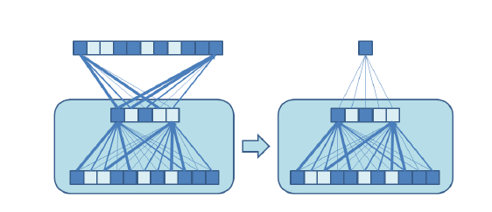
Auto-encoders (4)

Slide 28
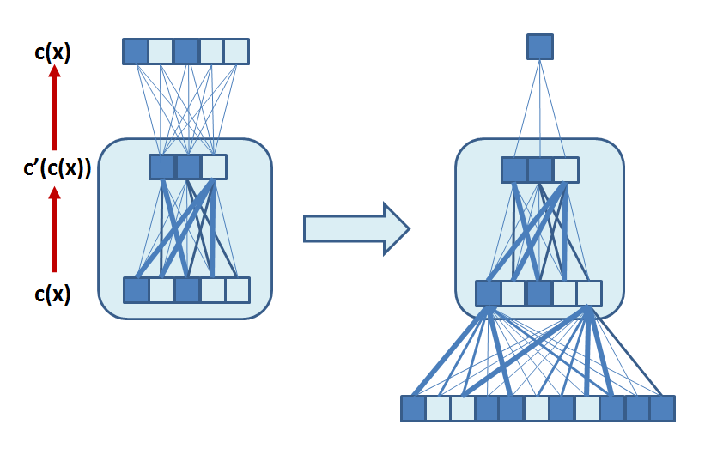
Auto-encoders (5)
A chain of subsequent hidden layers by iterating and composing subsequent encodings c’(c(x))
Appropriate numbers for the number of layers and the optimal number of units can be obtained pragmatically by cross-validation.
At each iteration, the auto-encoder derives a more compressed internal representation

Slide 29
Advanced training methods
Denoising auto-encoders
Add to each pattern x a random noise and ask the auto-encoding network to reconstruct the original noise-free pattern x.
This encourages the system to extract even stronger and more significant regularities from the input patterns

Slide 30
Advanced training methods(2)
Random dropout
In stochastic backpropagation training, each hidden unit is randomly omitted from the network with probability 0.5.
Each unit cannot rely on the presence of the other hidden units and is encouraged to identify useful information, independently of the other units.

Slide 31
Advanced training methods(3)
Curriculum learning
Training examples are presented to the network by starting from the easiest cases and then gradually proceeding to the more complex ones.

Slide 32
Gist
Multi-layer perceptron neural networks (MLPs) are a flexible (non-parametric) modeling architecture composed of layers of sigmoidal units interconnected in a feedforward manner only between adjacent layers.
Training from labeled examples can occur via variations of gradient descent (error backpropagation).
Although gradient descent is a weak optimization method, it yields successful practical results.

Slide 33
Gist(2)
Deep neural networks composed of many layers are becoming effective
Learning schemes for deep MLP consist of:
an unsupervised preparatory phase
a final tuning phase using the scarce labeled examples.

Slide 34
Gist(3)
To improve generalization, the use of controlled amounts of noise during training is effective
Increasing the effort during training pays dividends in terms of improved generalization

