Slide 1

Roberto Battiti, Mauro Brunato. The LION Way: Machine Learning plus Intelligent Optimization. LIONlab, University of Trento, Italy,
Apr 2015
http://intelligent-optimization.org/LIONbook
© Roberto Battiti and Mauro Brunato , 2015,
all rights reserved.
Slides can be used and modified for classroom usage,
provided that the attribution (link to book website)
is kept.

Slide 2
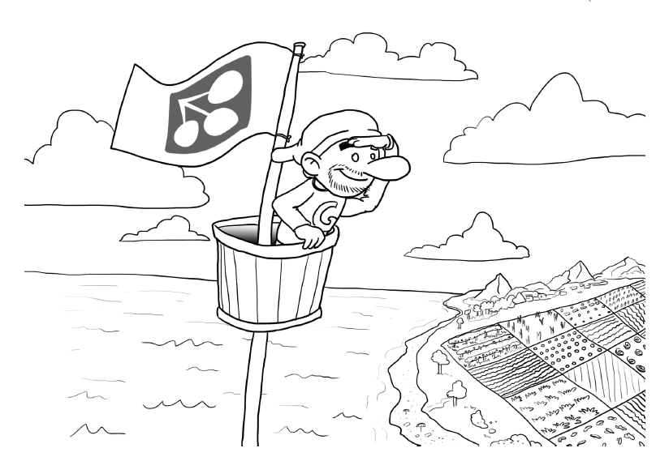
Chap.7 Ranking and selecting features
I don’t mind my eyebrows. They add. . . something to me. I wouldn’t say they were my best
feature, though. People tell me they like my eyes. They distract from the eyebrows.
(Nicholas Hoult)

Slide 3
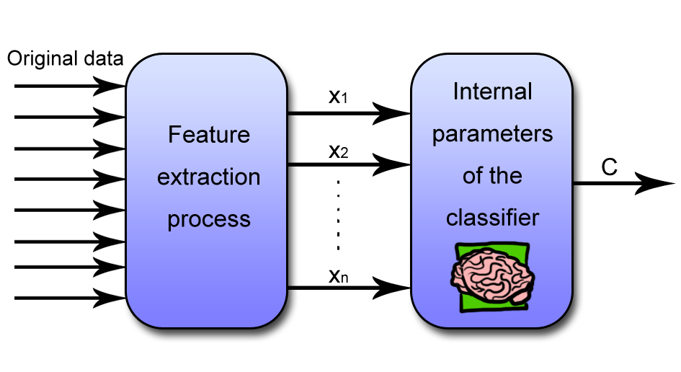
Feature selection

Slide 4
Feature selection (2)
Before starting to learn a model from the examples, one must be sure that the input data have sufficient information to predict the outputs, without excessive redundancy, which may causes “big” models and poor generalization
Feature selection is the process of selecting a subset of relevant features to be used in model construction.

Slide 5
Reasons for feature selection
Selecting a small number of informative features has advantages:
Dimensionality reduction
Memory usage reduction
Improved generalization
Better human understanding

Slide 6
Methods for feature selection
Feature selection is a problem with many possible solutions: no simple recipe.
Use the designer intuition and existing knowledge
Estimate the relevance or discrimination power of the individual features

Slide 7
Wrapper, Filter and Embedded methods
The value of a feature is related to a model-construction method. Three classes of methods:
Wrapper methods are built “around” a specific predictive model (measure error rate)
Filter methods use a proxy measure instead of the error rate to score a feature subset
Embedded methods perform feature selection as an integral part of the model construction process.

Slide 8
Top-down and Bottom-up methods
In a bottom-up method one gradually adds the ranked features in the order of their individual discrimination power and stops when the error rate stops decreasing
In a top-down truncation method one starts with the complete set of features and progressively eliminates features while searching for the optimal performance point

Slide 9

Linear models
Can we associate the importance of a feature to its weight?
Careful with ranges and scaling.
Normalization helps.

Slide 10
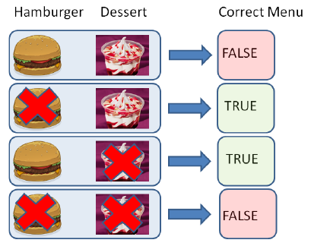
Nonlinearities and mutual relationships between features
Measuring individual features in isolation will discard mutual relationships → selection can be suboptimal
XOR function of two inputs
E.g., to get a proper meal one needs to eat either a hamburger or a dessert but not both.
The individual presence or absence of a hamburger (or of a dessert) in a menu will not be related to classifying a menu as correct or not.

Slide 11


Correlation coefficient
Pearson correlation coefficient: widely used measure of linear relationship between numeric variables.
Y random variable associated with the output
Xi random variable associated with an input
Examples of data distributions and corresponding correlation values

Slide 12
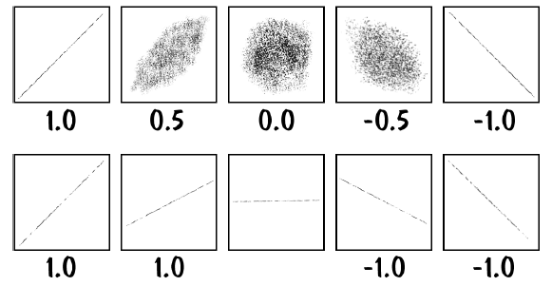
Correlation coefficient (2)
Examples of data distributions and corresponding correlation values

Slide 13

Correlation Ratio
Correlation ratio is used to measure a relationship between a numeric input and a categorical output.
significant →at least one outcome class where the feature’s average value is significantly different from the average on all classes
Let L_y be the number of times that outcome y appears, so that one can partition the sample input vectors by their output:
Inpuuts leading to output y

Slide 14



Correlation ratio (2)
Average of the i-th feature within each output class:
Overall average:
Correlation ratio between the i-th feature and outcome:

Slide 15
Statistical hypothesis testing
A statistical hypothesis test is a method of making statistical decisions by using experimental data.
Hypothesis testing answers the question: Assuming that the null hypothesis is true, what is the probability of observing a value for the test statistic that is at least as large as the value that was actually observed? Reject if prob. is too low.
Statistically significant ←→ unlikely to have occurred by chance.

Slide 16
Relationship between two categorical features
Null hypothesis that the two events “occurrence of term t” and “document of class c” are independent, the expected value of the above counts for joint events are obtained by multiplying probabilities of individual events
If the count deviates from the one expected for two independent events, one can conclude that the two events are dependent, and that therefore the feature is significant to predict the output. Check if the deviation is sufficiently large that it cannot happen by chance.

Slide 17

Chi-squared test
Chi-squared statistic:
where countc,t is the number of occurrences of the value t given the class c
the best features are the ones with larger χ2 values
If independent

Slide 18

Mutual information (1): Entropy
The uncertainty in an output distribution can be measured from its entropy:
After knowing a specific input value x, the uncertainty in the output can decrease

Slide 19


Mutual information (2): Conditional Entropy
The entropy of Y after knowing the i-th input feature value is
The conditional entropy of variable Y is the expected value of H(Y|xi)

Slide 20

Mutual Information (3)
Mutual information between Xi and Y :
The amount by which the uncertainty decreases
An equivalent expression which clarifies the symmetry between Xi and Y:
Mutual Information captures arbitrary non-linear dependencies between variables

Slide 21
GIST
Reducing the number of input attributes used by a model, while keeping roughly equivalent performance, has many advantages.
It is difficult to rank individual features without considering the specific modeling method and their mutual relationships.

Slide 22
GIST 2
Trust the correlation coefficient only if you have reasons to suspect linear relationships
Correlation ratio can be computed even if the outcome is not quantitative
Use chi-square to identify possible dependencies between inputs and output
Use mutual information to estimate arbitrary dependencies between qualitative or quantitative features

