Slide 1
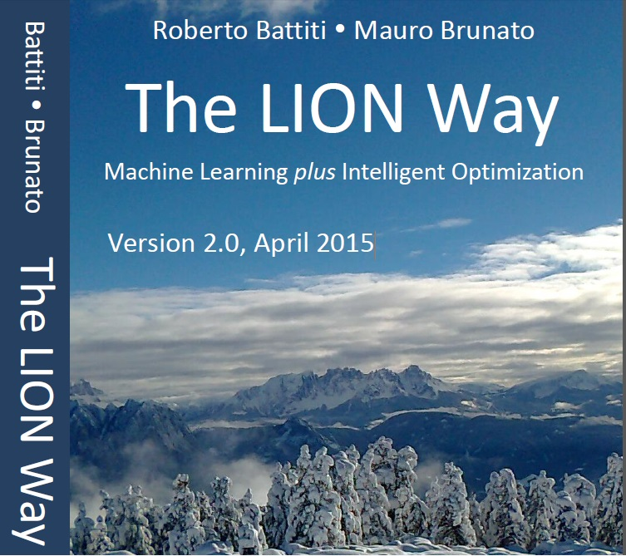
Roberto Battiti, Mauro Brunato. The LION Way: Machine Learning plus Intelligent Optimization. LIONlab, University of Trento, Italy,
Apr 2015
http://intelligent-optimization.org/LIONbook
© Roberto Battiti and Mauro Brunato , 2015,
all rights reserved.
Slides can be used and modified for classroom usage,
provided that the attribution (link to book website)
is kept.

Slide 2
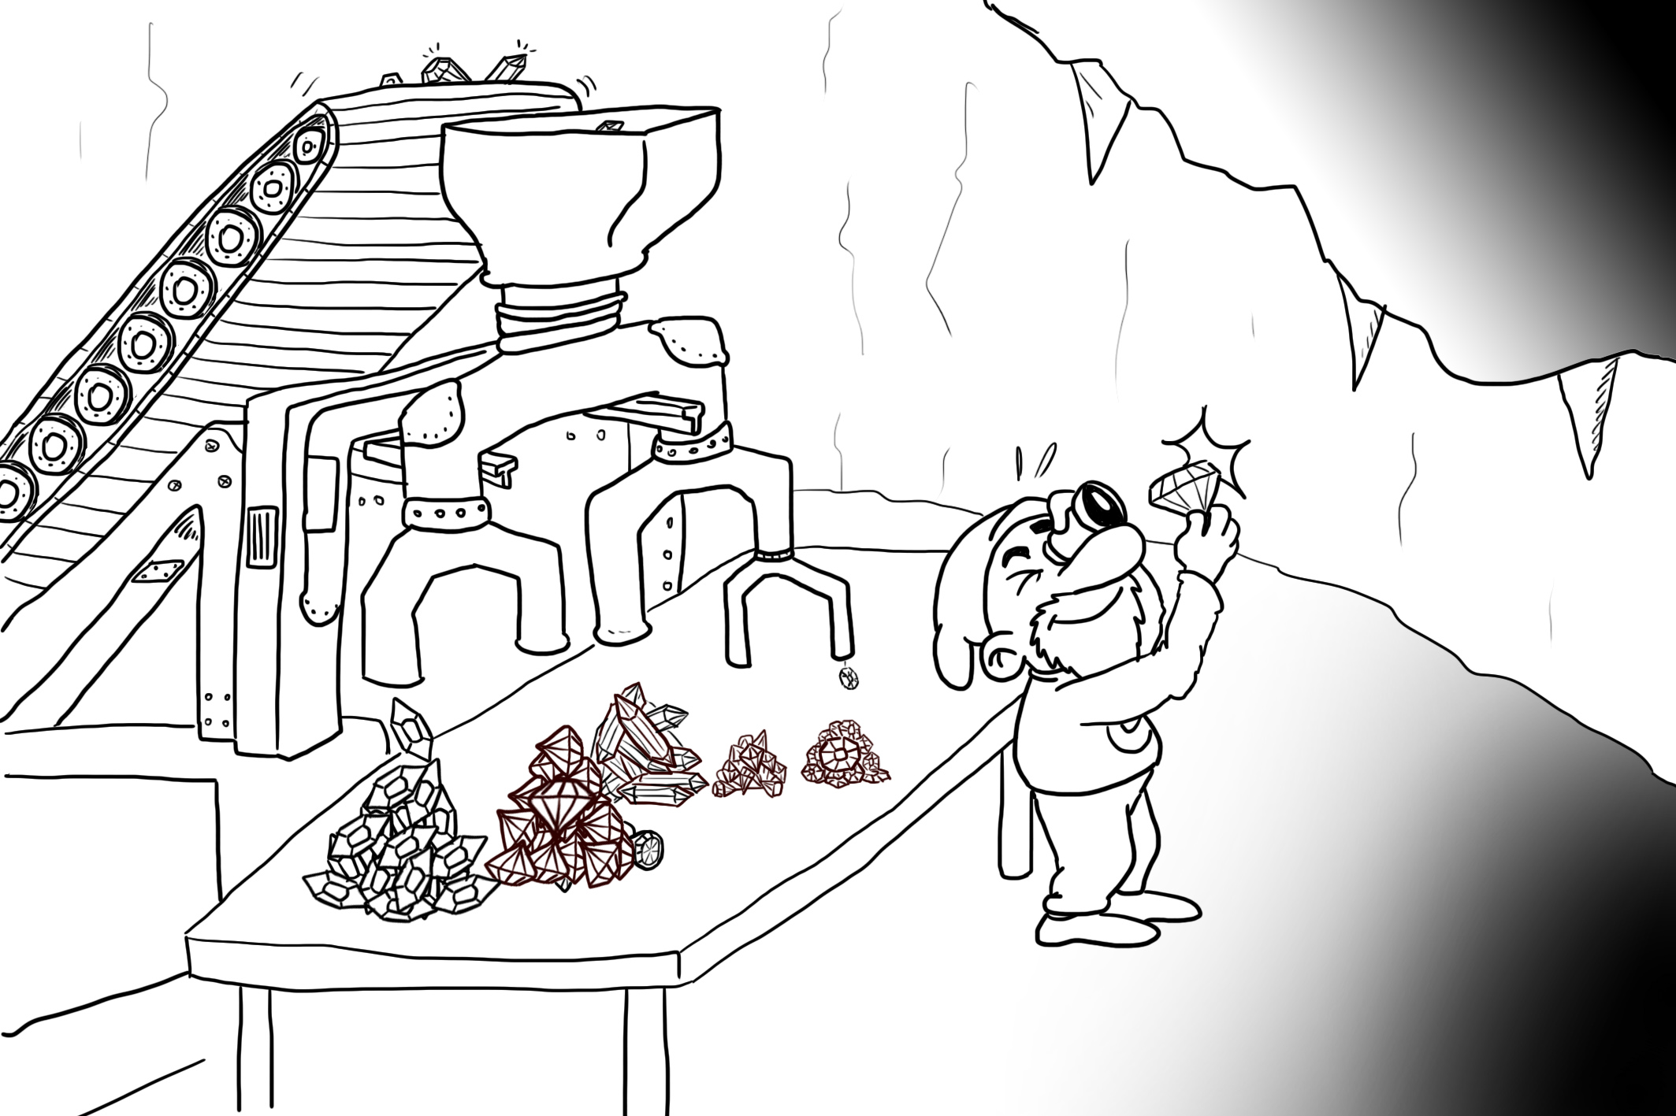
Chap.6 Rules, decision trees, and forests
If a tree falls in the forest and there’s no one there to hear it, does it make a sound?

Slide 3
Rules
Rules are a way to condense nuggets of knowledge in a way amenable to human understanding
“customer is wealthy” “he will buy my product.”
“body temperature > 37 degrees Celsius” “patient is sick.”

Slide 4
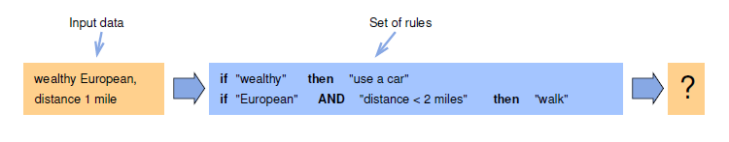
Non-contradictory sets of rules
If the set of rules gets large, complexities can appear, like rules leading to contradictory classifications
Automated ways to extract non-contradictory rules from data are precious

Slide 5
Automated generation of rules
breaking rules into a chain of simple questions is key
the most informative questions are better placed at the beginning of the sequence, leading to a hierarchy of questions
decision trees are organized hierarchical arrangement of decision rules, without contradictions

Slide 6
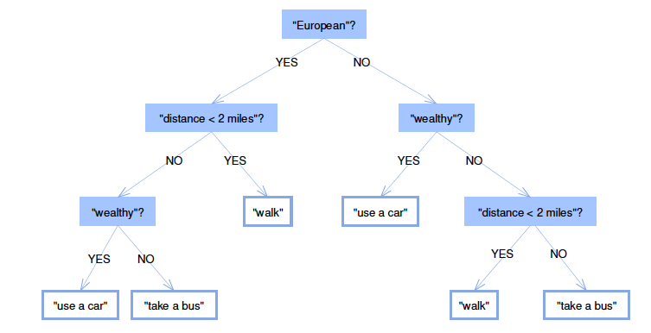
Decision trees
A decision tree is a set of questions organized in a hierarchical manner and represented graphically as a tree

Slide 7
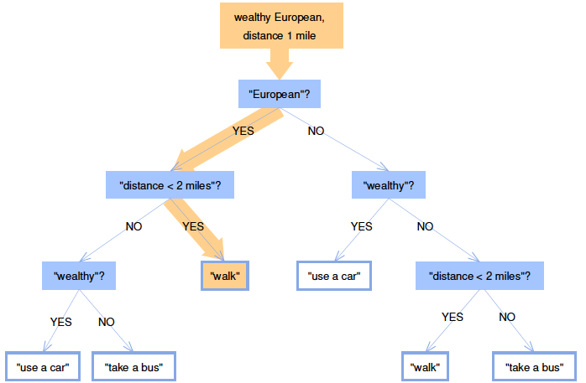
Decision trees
For an input object, a decision tree estimates an unknown property by asking successive questions about its known properties

Slide 8
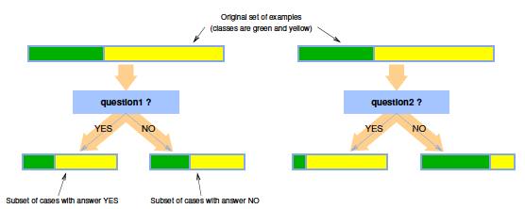
Building decision trees
Basic idea: ask the most informative questions first
Recursively construct a hierarchy of questions
At each step, choose the question that leads to the purest subsets

Slide 9
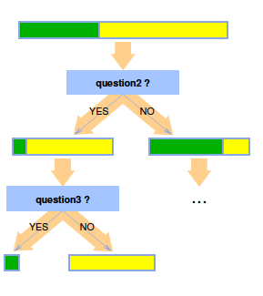
Building decision trees
Recursive step in tree building:
after the initial purification by question2 ,the same method is applied on the left and right example subsets.
Question3 is sufficient to completely purify the subsets.
No additional recursive call is executed on the pure subsets

Slide 10
How do we measure purity?
We need a quantitative measure of purity
The two widely used measures of purity of a subset are the
Information gain
Gini impurity

Slide 11

Shannon Entropy
Suppose we sample from a set associated to an internal node or to a leaf of the tree
We are going to get examples of a class y with a probability Pr(y) proportional to the fraction of cases of the class present in the set
The statistical uncertainty in the obtained class is measured by Shannon’s entropy of the label probability distribution:

Slide 12
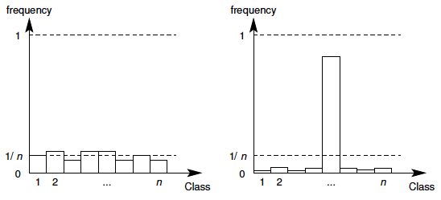
Shannon entropy
High entropy (left): events have similar probabilities, the uncertainty high.
Low entropy (right): events have very different probabilities, the uncertainty is because one event collects most probability.

Slide 13

Information Gain
The average reduction in entropy after knowing the answer is the information gain (or mutual information)
An optimal question maximizes IG, that is, reduces the average entropy as much as possible.
S is the current set of examples, S=S_yes U S_no is the splitting obtained after answering a question

Slide 14
Gini impurity
Suppose that there are m classes, and let f_i be the fraction of items labeled with value i in the set.
Then the Gini Impurity is defined as
The Gini impurity measures how often a randomly chosen element from the set would be incorrectly labeled if it were randomly labeled according to the distribution of labels in the subset
This method produces zero errors if the set
is pure, and a small error rate if a single class gets the largest share of the set

Slide 15
How to pose questions?
In general, question should have a binary output.
For a categorical variable, the test can be based on the variable having (or not having) a subset of the possible values
For real-valued variables, the tests can be on a single variable or on simple (linear) combination of a subset of variables

Slide 16
Dealing with missing values
In real-world data, missing values are abundant
If an instance reaches a node and the question cannot be answered because data is lacking, ideally “split the instance into pieces”, and send part of it down each branch in proportion to the number of training instances going down that branch.
When the different pieces of the instance eventually reach the leaves, the corresponding leaf output values can be averaged.

Slide 17
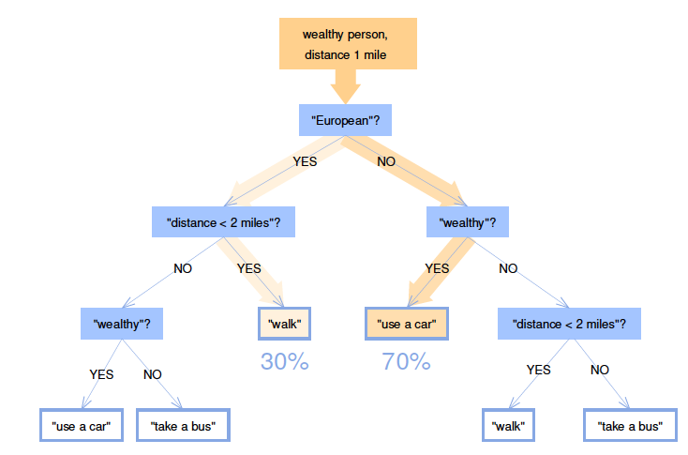
Dealing with missing values
Missing nationality information. The data point arriving at the top node
is sent both to its left and right child nodes with different weights depending on the frequency of “YES” and “NO” answers in the training set.

Slide 18
Decision forests
Basic idea: use an ensemble of trees to make decisions in a democratic way
HOW?
Train different trees on different sets of examples
Allow for randomized choices during training
an isolated tree will be rather weak, however, the majority (or weighted average) rule will provide reasonable answers.

Slide 19
Gist
Simple “if-then” rules condense nuggets of information in a way which can be understood by human people.
To avoid contradictory rules we proceed with a hierarchy of questions (the most informative first) leading to an organized structure of simple successive questions called a decision tree

Slide 20
Gist2
Trees can be learned in a greedy and recursive manner, starting from the complete set of examples, picking a test to split it into two subsets which are as pure as possible
The recursive process terminates when the remaining subsets are sufficiently pure

Slide 21
Gist3
The abundance of memory and computing power permits training very large numbers of different trees. They can be fruitfully used as decision forests by collecting all outputs and averaging (regression) or voting (classification).
They are fast and efficient thanks to their parallelism and reduced set of tests per data point.

