Slide 1

Roberto Battiti, Mauro Brunato. The LION Way: Machine Learning plus Intelligent Optimization. LIONlab, University of Trento, Italy,
Apr 2015
http://intelligent-optimization.org/LIONbook
© Roberto Battiti and Mauro Brunato , 2015,
all rights reserved.
Slides can be used and modified for classroom usage,
provided that the attribution (link to book website)
is kept.

Slide 2

Chap.4 Linear models
Most right-handed people are linear thinking, think inside the box.

Slide 3
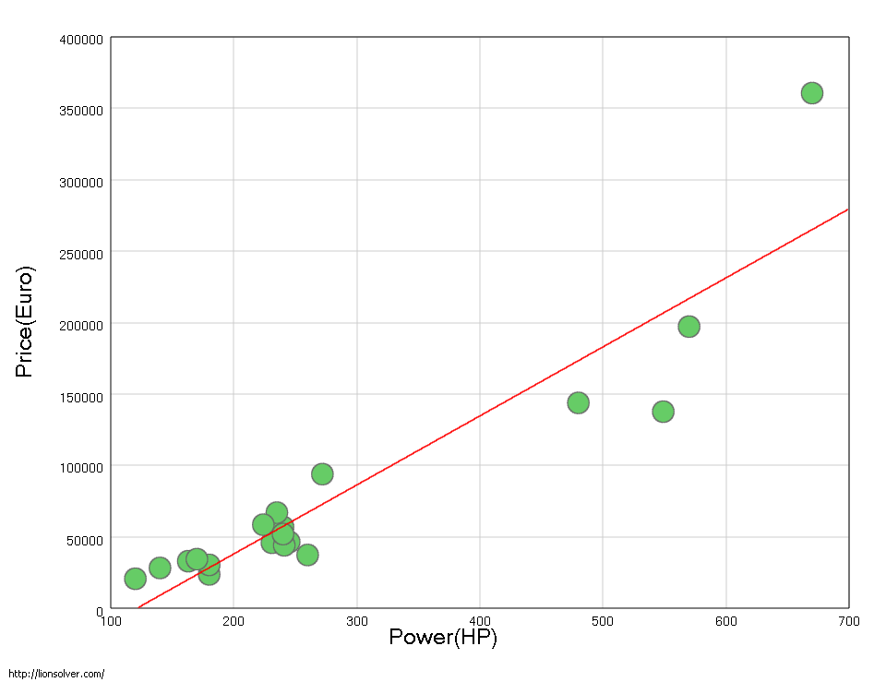
Linear models
Just below the mighty power of optimization lies the awesome power of linear algebra.
Data about price and power of different car models. A linear model (fit) is shown.

Slide 4
Linear regression
A linear dependence of the output from the input features
f(x) = w1 x1 + w2 x2 + … + wd xd.
The model is simple, can be easily trained,
The computed weights in the linear summation provide a direct explanation of the importance of the various attributes

Slide 5



Best (linear) fit → optimization
Errors can be present (every physical quantity can be measured only with a finite precision)
Determine optimal weight vector w so that:
approximates as closely as possible the experimental data
minimizes the sum of the squared errors (least squares approximation):

Slide 6

Least-squares
In the unrealistic case of zero measurement errors and a perfect linear model, one is left with a set of linear equations:
In all real-world cases measurement errors are present, and the number of measurements (xi; yi) can be much larger than the input dimension. Therefore one needs to search for an approximated solution, for weights w obtaining the lowest possible value of the error.
How? Trust optimization (this case is standard! Use pseudo-inverse in linear algebra, see later)

Slide 7



A trick for nonlinear dependencies
f(x) = w^{T} x is too restrictive, In particular, it assumes that f(0) = 0
f(x) = w0 + w^{T} x (affine model) by adding a dimension and fixing the value to 1:
x = (1; x1; …; xd)
Linear model on nonlinear features

Slide 8
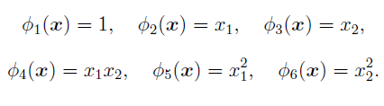
A trick for nonlinear dependencies
E.g., a quadratic model with tow inputs is linear in the following features

Slide 9
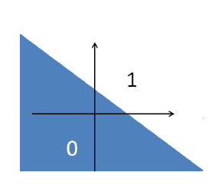

Linear models for classification
Let the outcome variable be two-valued (e.g., +/- 1). Linear functions can be used as discriminants
hyperplane defined by a vector w separating the two classes
(examples marked as red / orange)
+1
-1

Slide 10
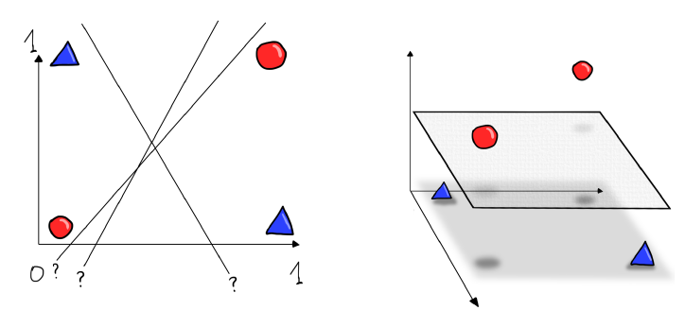
Counter-example: XOR function
Cannot separate points with a line in two dim.
But points can be separated by a plane after mapping them into 3D

Slide 11
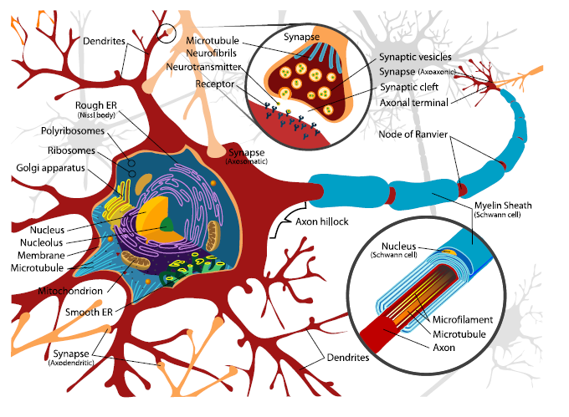
Biological motivations
Neurons and synapses in the human brain

Slide 12
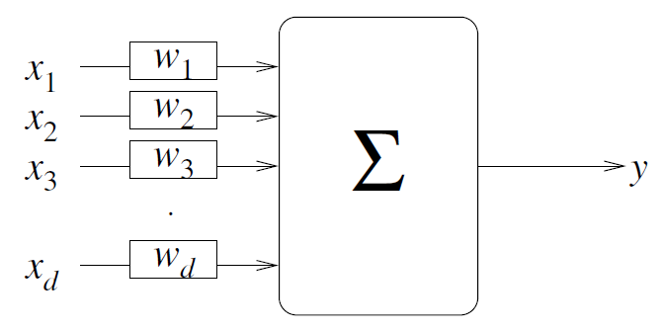
Abstract model: the perceptron
Output is a weighted sum of the inputs passed through a final threshold function.

Slide 13

Why are linear models successful?
smoothness underlying many physical phenomena
every smooth (differentiable) function can be approximated around an operating point xc with its Taylor series approximation
Linear part

Slide 14
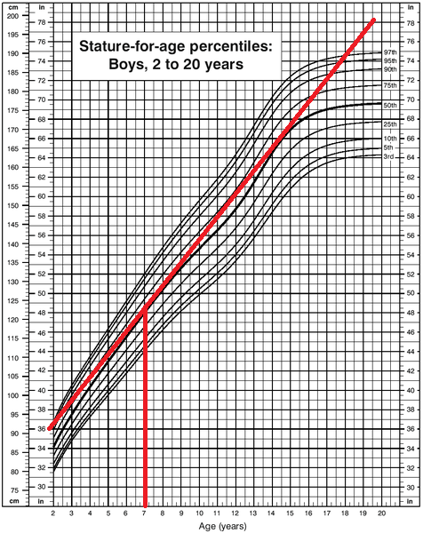
Why are linear models popular and successful?
Example:
The stature-for-age curve can be approximated well by a tangent line (red) from 2 to about 15 years.

Slide 15
Minimizing the sum of squared errors
If zero measurement errors and a perfect linear model:
set of linear equations w^{T} xi= yi one for each example
in real-world cases, reaching zero for the ModelError is impossible, and the number of data points can be much larger than the number of parameters d.
furthermore, the goal of learning is generalization
(and requiring zero error can cause “overtraining”)

Slide 16

Minimizing the sum of squared errors
Error is quadratic in parameters w
Find minimum:
take partial derivatives
equate them to 0
Obtain linear equations, typically more equations than examples

Slide 17

Minimizing the sum of squared errors
From inverse to pseudo-inverse, solution is:
where y = (y1; …; yL) and X is the matrix whose rows are the xi vectors.
least-square and pseudo-inverse are among the most popular tools
alternative is gradient descent

Slide 18
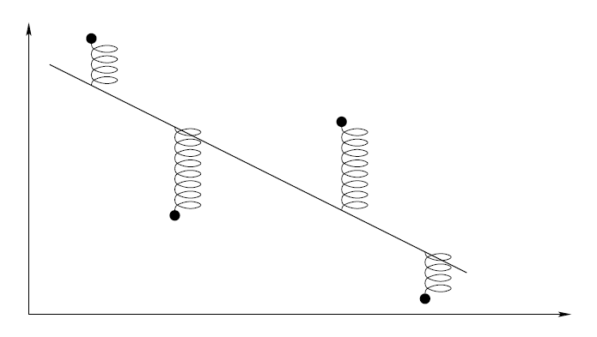
An analogy in Physics
Spring analogy for least squares fits.
Springs connect a rigid bar to the experimental points.
The best fit is the line that minimizes the overall potential energy of the system (proportional to thesum of the squares of the spring length).

Slide 19
Numerical instabilities
Each number is assigned a fixed number of bits, no way to represent 3.14159265...
Mistakes will propagate during mathematical operations
Stability here means that small perturbations of the sample points lead to small changes in the results

Slide 20
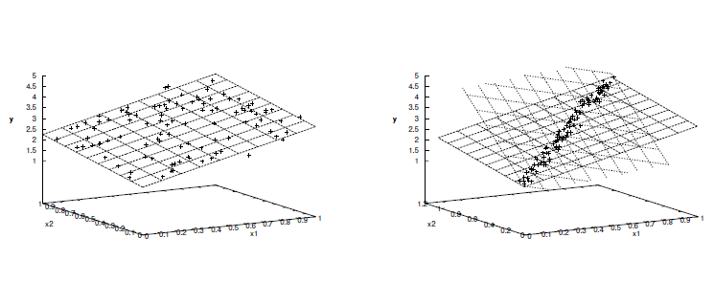
Numerical instabilities
A well-spread training set (left) provides a stable numerical model, whereas a bad choice of sample points (right) may result in wildly changing planes, including very steep ones

Slide 21
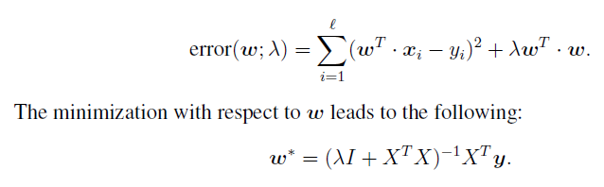
Ridge regression to cure instability
Regularization term
The insertion of a small diagonal term makes
the inversion more robust.

Slide 22
Gist
Traditional linear models for regression (linear approximation of a set of input/output pairs) identify the best possible linear fit of experimental data by minimizing a sum the squared errors between the values predicted by the linear model and the training examples.
Minimization can be “one shot” by generalizing matrix inversion in linear algebra, or iteratively, by gradually modifying the model parameters to
lower the error. The pseudo-inverse method is possibly the most used technique for fitting experimental data.

Slide 23
Gist (2)
In classification, linear models aim at separating examples with lines, planes and hyper-planes. To identify a separating plane one can require a mapping of the inputs to two distinct output values (like +1 and -1) and use regression.
Real numbers in a computer do not exist and their approximation by limited-size binary numbers is a possible cause of mistakes and instability (small perturbations of the sample points leading to large changes in the results).
Some machine learning methods are loosely related to the way in which biological brains work.

