Slide 1
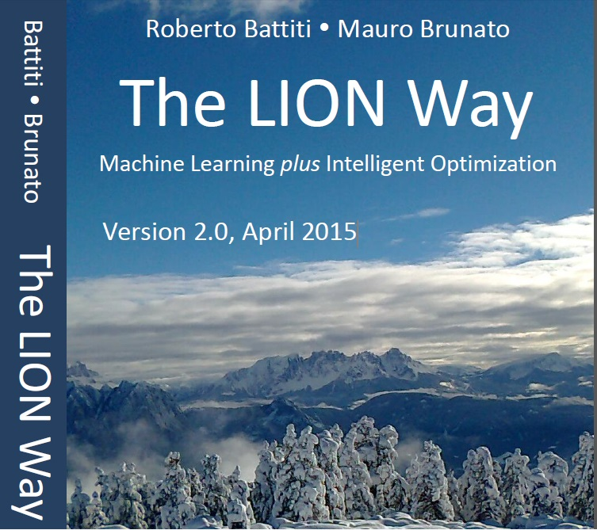
Roberto Battiti, Mauro Brunato.
The LION Way: Machine Learning plus Intelligent Optimization.
LIONlab, University of Trento, Italy,
Apr 2015
http://intelligent-optimization.org/LIONbook
© Roberto Battiti and Mauro Brunato , 2015,
all rights reserved.
Slides can be used and modified for classroom usage,
provided that the attribution (link to book website)
is kept.

Slide 2
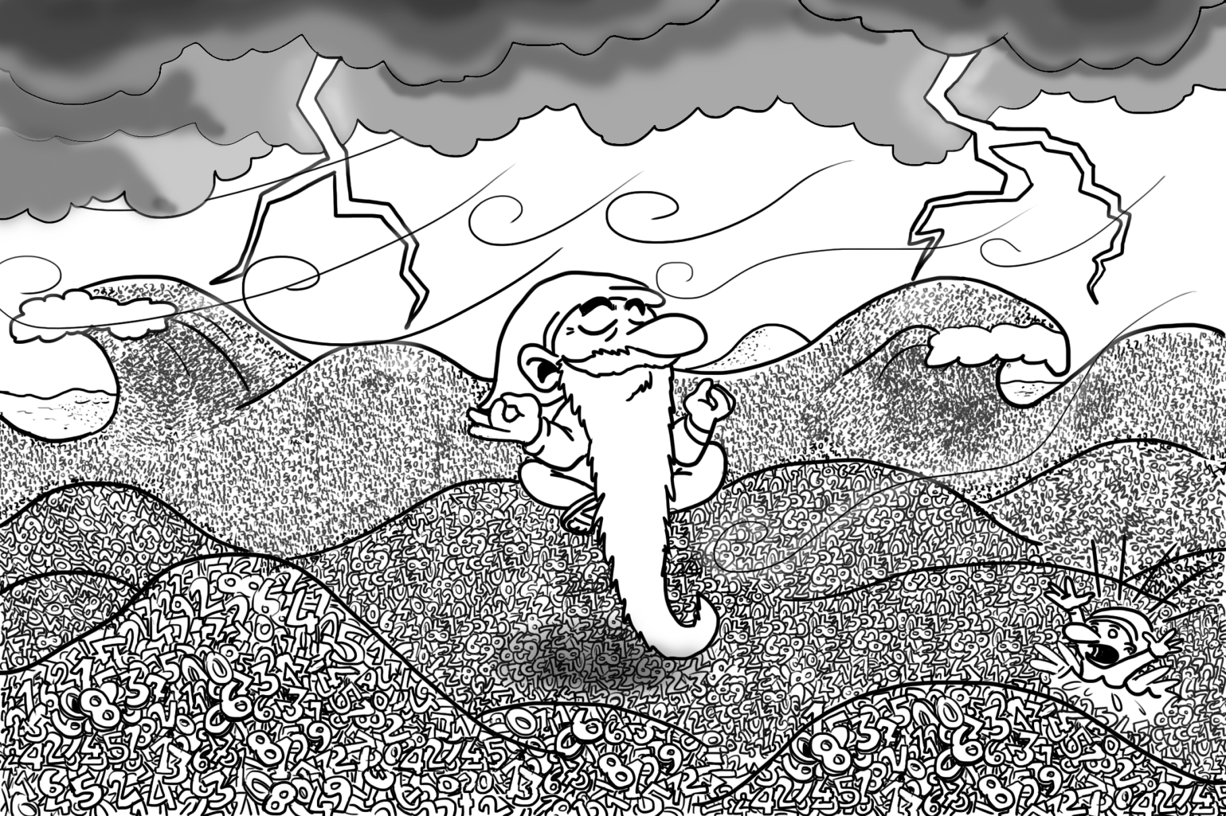
Chap.3 Learning requires a method
Data Mining, noun 1. Torturing the data until it confesses. . . and if you torture it long enough,
you can get it to confess to anything.

Slide 3
What is learning?
Unifying different cases by discovering the underlying explanatory laws.
Learning from examples is only a means to reach the real goal: generalization, the capability of explaining new cases

Slide 4
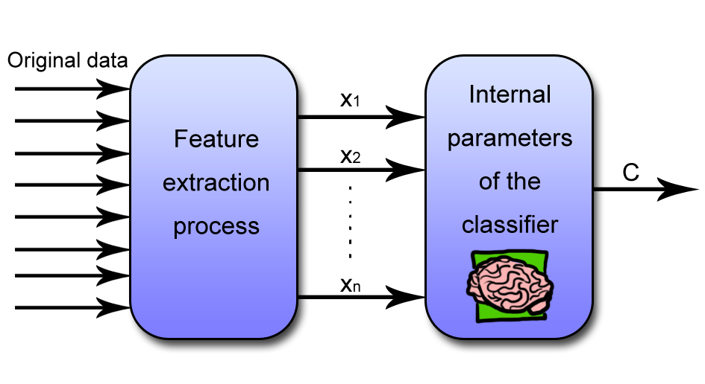
Supervised learning architecture: feature extraction and classification

Slide 5
Performance estimation
If the goal is generalization, estimating the performance has to be done with extreme care
Feature extraction →
(xi; yi), i = 1;...; L
Classification
Regression
Output can be probability

Slide 6
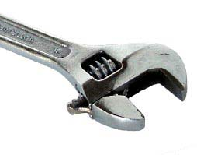
Learning from labeled examples: minimization and generalization
A flexible model f(x;w), where the flexibility is given by some tunable parameters (or weights) w
determination of the best parameters is fully automated, this is why the method is called machine learning after all

Slide 7
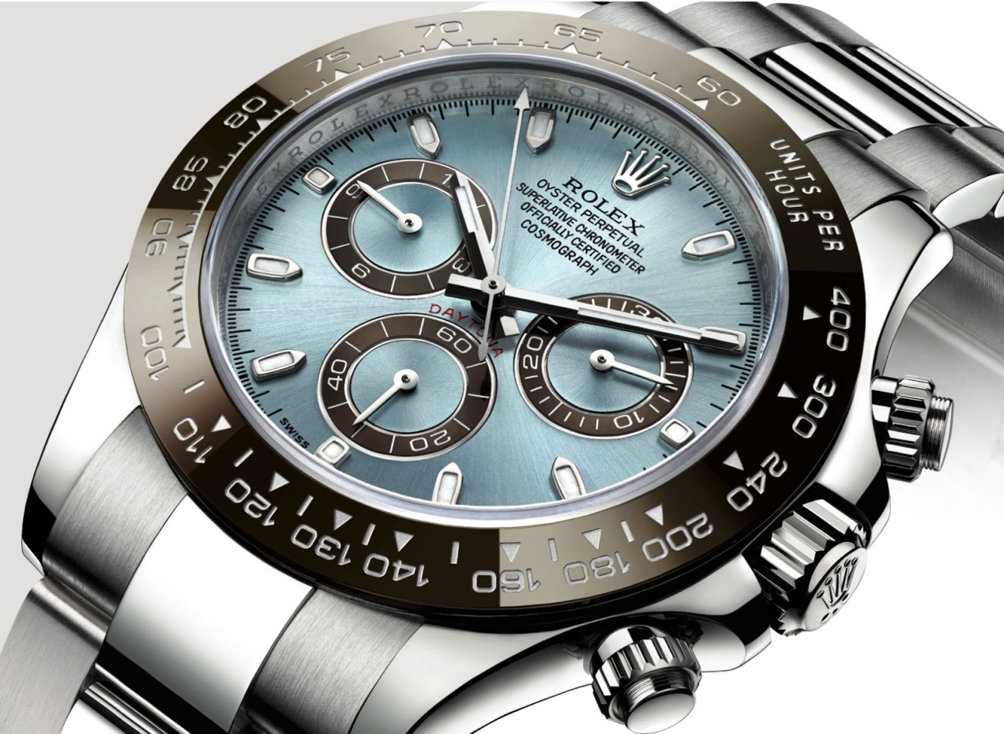
Flexible model with internal parameters (mental images)

Slide 8
Learning from labeled examples: minimization and generalization (2)
fix the free parameters by demanding that the learned model works correctly on the examples in the training set.
power of optimization: we start by defining an error measure to be minimized, an automated optimization process to determine optimal parameters

Slide 9
Learning from labeled examples: minimization and generalization (3)
suitable error measure is the sum of the errors between the correct answer (given by the example label) and the outcome predicted
if the function is smooth one can discover points of low altitude by being blindfolded and parachuted to a random initial point…
(gradient descent)

Slide 10
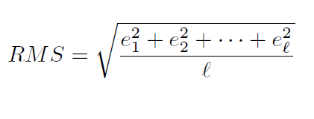
RMS (root mean square) error function
Indivisual errors
Square
Average (Sum and divide)
Square root is optional... (optimizing sum of squares or its square root leads to the sam eresult)

Slide 11
Bias-Variance dilemma
minimization of an error function is a first critical component, but not the only one.
We are interested in generalization → Model complexity matters!

Slide 12
Bias-Variance dilemma
Models with too few parameters are inaccurate because of a large bias: they lack flexibility.
Models with too many parameters are inaccurate because of a large variance: they are too sensitive to the sample details (changes in the details will produce huge variations).
Identifying the best model requires identifying the proper “model complexity”, i.e., the proper architecture and number of parameters.

Slide 13
Learn, validate, test!
careful experimental procedures to measure the effectiveness of the learning process.
It is a terrible mistake to measure the performance of the learning systems on the same examples used for training
The test set is used only once for a final measure of performance.

Slide 14
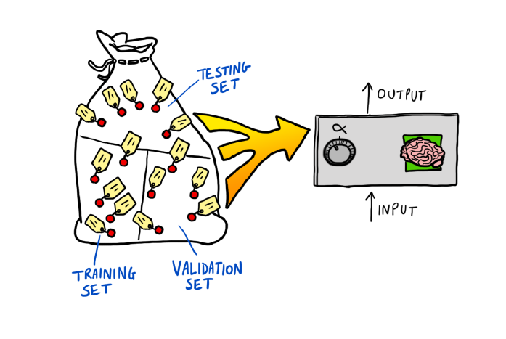
Learn, validate, test!

Slide 15
K-fold Cross-validation
the original sample is randomly partitioned into K subsamples.
A single subsample is used as the validation data for testing, and the remaining K - 1 subsamples are used as training data.
The cross-validation process is then repeated K times (the folds), with each of the K subsamples used exactly once as the validation data.
Validation results are averaged

Slide 16
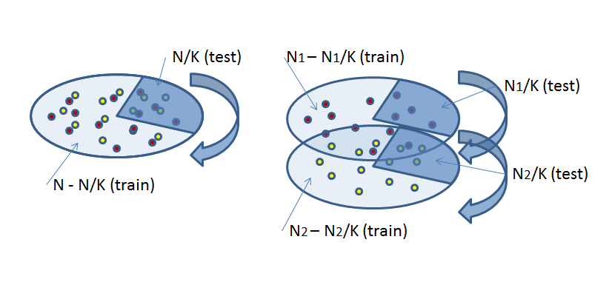
K-fold Cross-validation
Advanced: stratification helps in classification (subdivide each class)

Slide 17
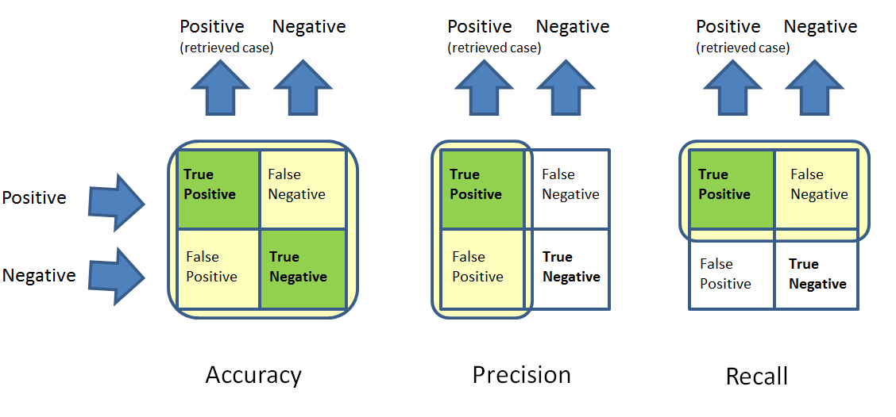
Errors of different kinds

Slide 18
Errors of different kinds
Accuracy is defined as the fraction of correct answers over the total
Precision as the fraction of correct answers over the number of retrieved (positive) cases
Recall is computed as the fraction of correct answers over the number of relevant (true positive) cases.

Slide 19
Gist
The goal of machine learning is to use a set of training examples to realize a system which will correctly generalize to new cases, in the same context but not seen during learning.
ML learns, i.e., determines appropriate values for the free parameters of a flexible model, by automatically minimizing a measure of the error on the example set, possibly corrected to discourage complex models, and therefore improving the chances of correct generalization.
The output value of the system can be a class (classification), or a number (regression). In some cases having as output the probability for a class increases flexibility of usage.

Slide 20
Gist
Accurate classifiers can be built without any knowledge elicitation phase, just starting from an abundant and representative set of example data. This is a dramatic paradigm change.
ML is very powerful but requires a strict method (a kind of “pedagogy” of ML). For sure, never estimate performance on the training set — this is a mortal sin: be aware that re-using validation data will create optimistic estimates. If examples are scarce, use cross-validation to show off that you are an expert ML user.
To be on the safe side, set away some test examples and use them only once at the end to estimate performance.
There is no single way to measure the performance of a model, different kinds of mistakes can have very different costs. Accuracy, precision and recall are some possibilities, a confusion matrix is giving the complete picture for more classes.

