Slide 1

Roberto Battiti, Mauro Brunato.
The LION Way: Machine Learning plus Intelligent Optimization.
LIONlab, University of Trento, Italy,
Apr 2015
http://intelligent-optimization.org/LIONbook
© Roberto Battiti and Mauro Brunato , 2015,
all rights reserved.
Slides can be used and modified for classroom usage,
provided that the attribution (link to book website)
is kept.

Slide 2
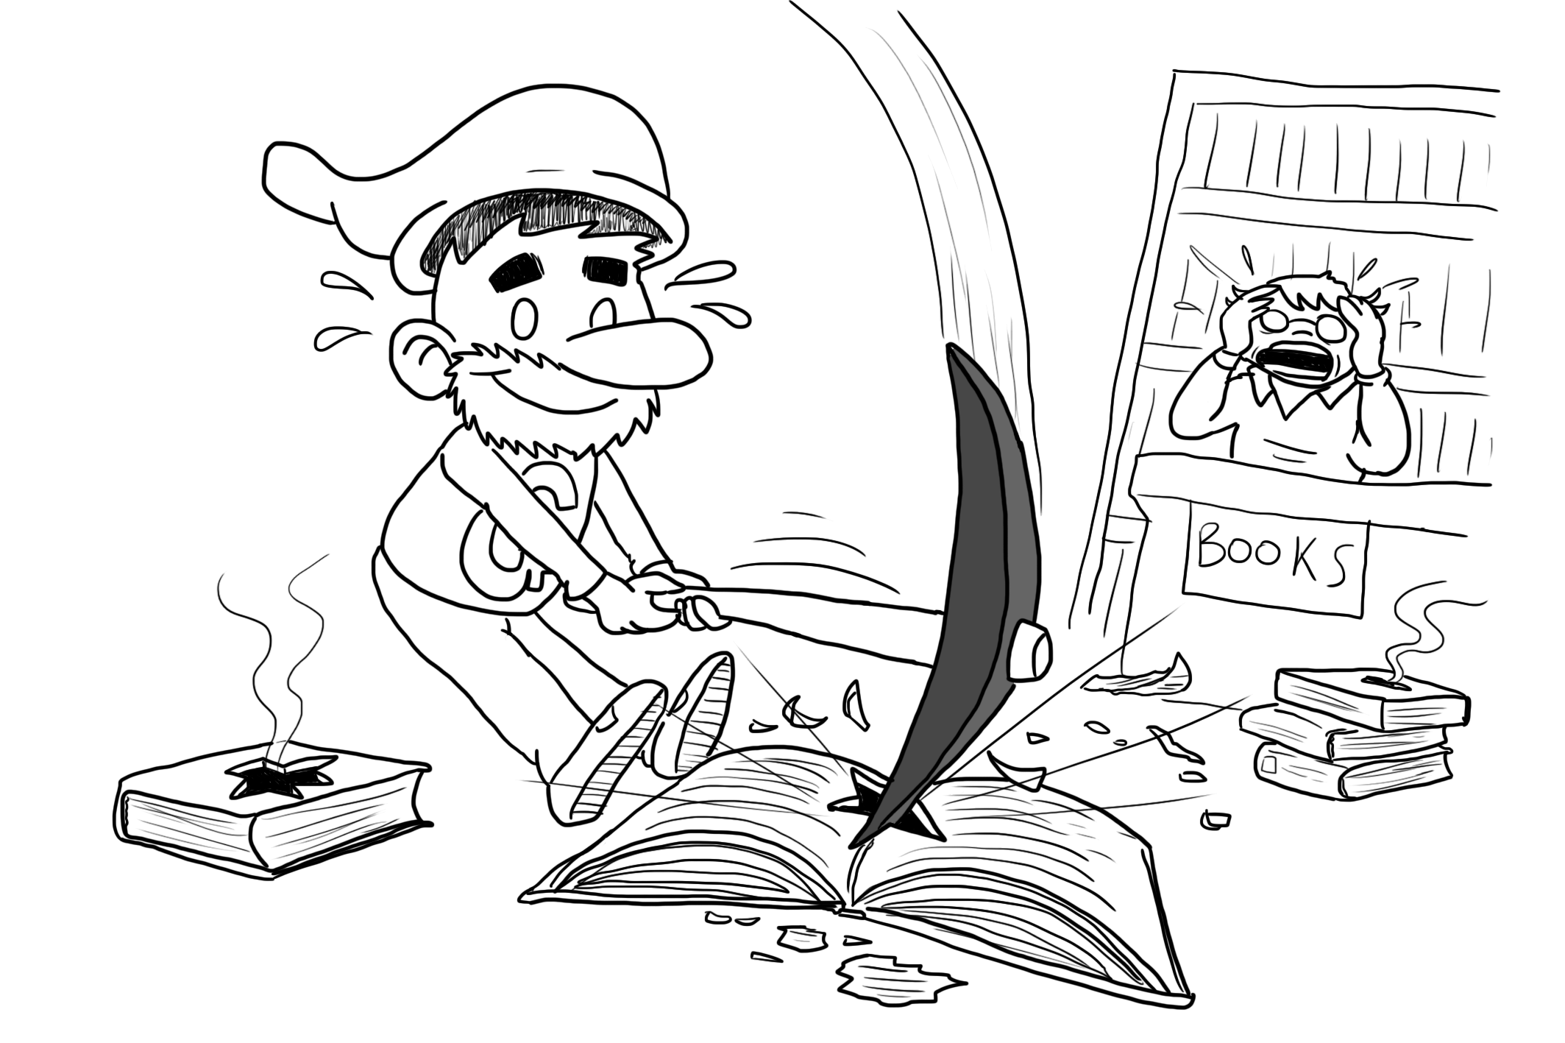
Text and web mining – part II
Wholly new forms of encyclopedias will appear, ready made with a mesh of associative trails running through them, ready to be dropped into the memex and there amplified.
(Vannevar Bush, 1945)

Slide 3
Using hyperlinks to rank web pages
Problem: given a query, how to retrieve a set of high quality and relevant pages from the Web.
In scientific communities, a paper is considered of good quality if it is cited by other good quality papers (citation analysis in Bibliometrics)
Analogy: a candidate for employment is valued if many other valued people are prepared to recommend him

Slide 4
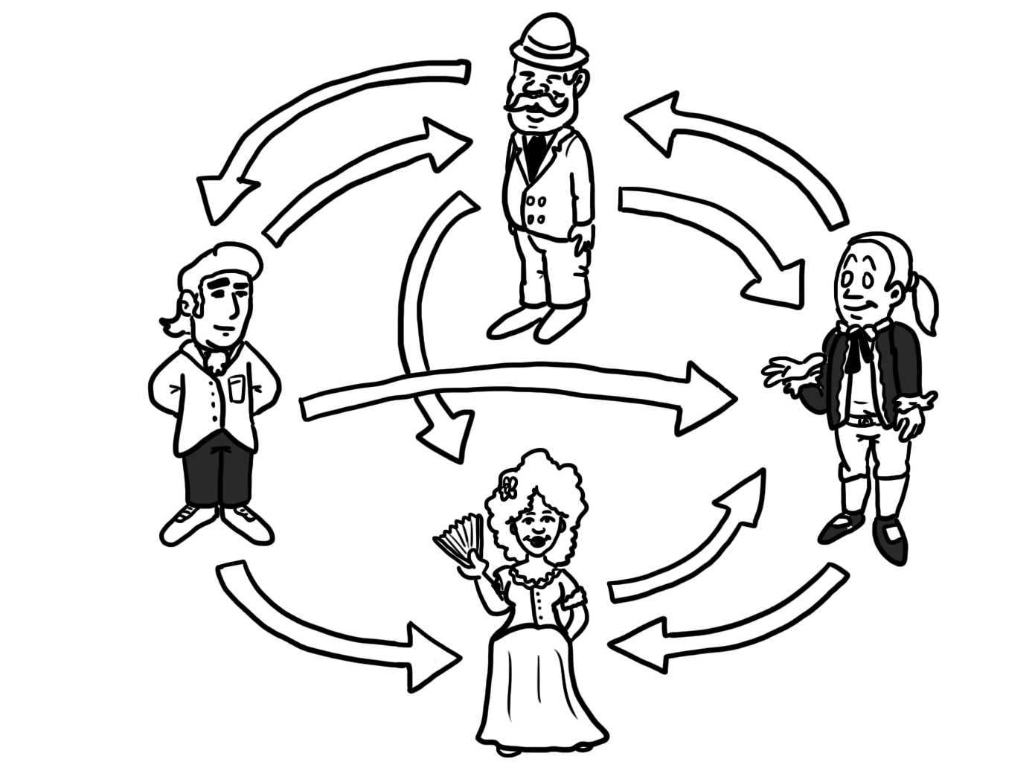
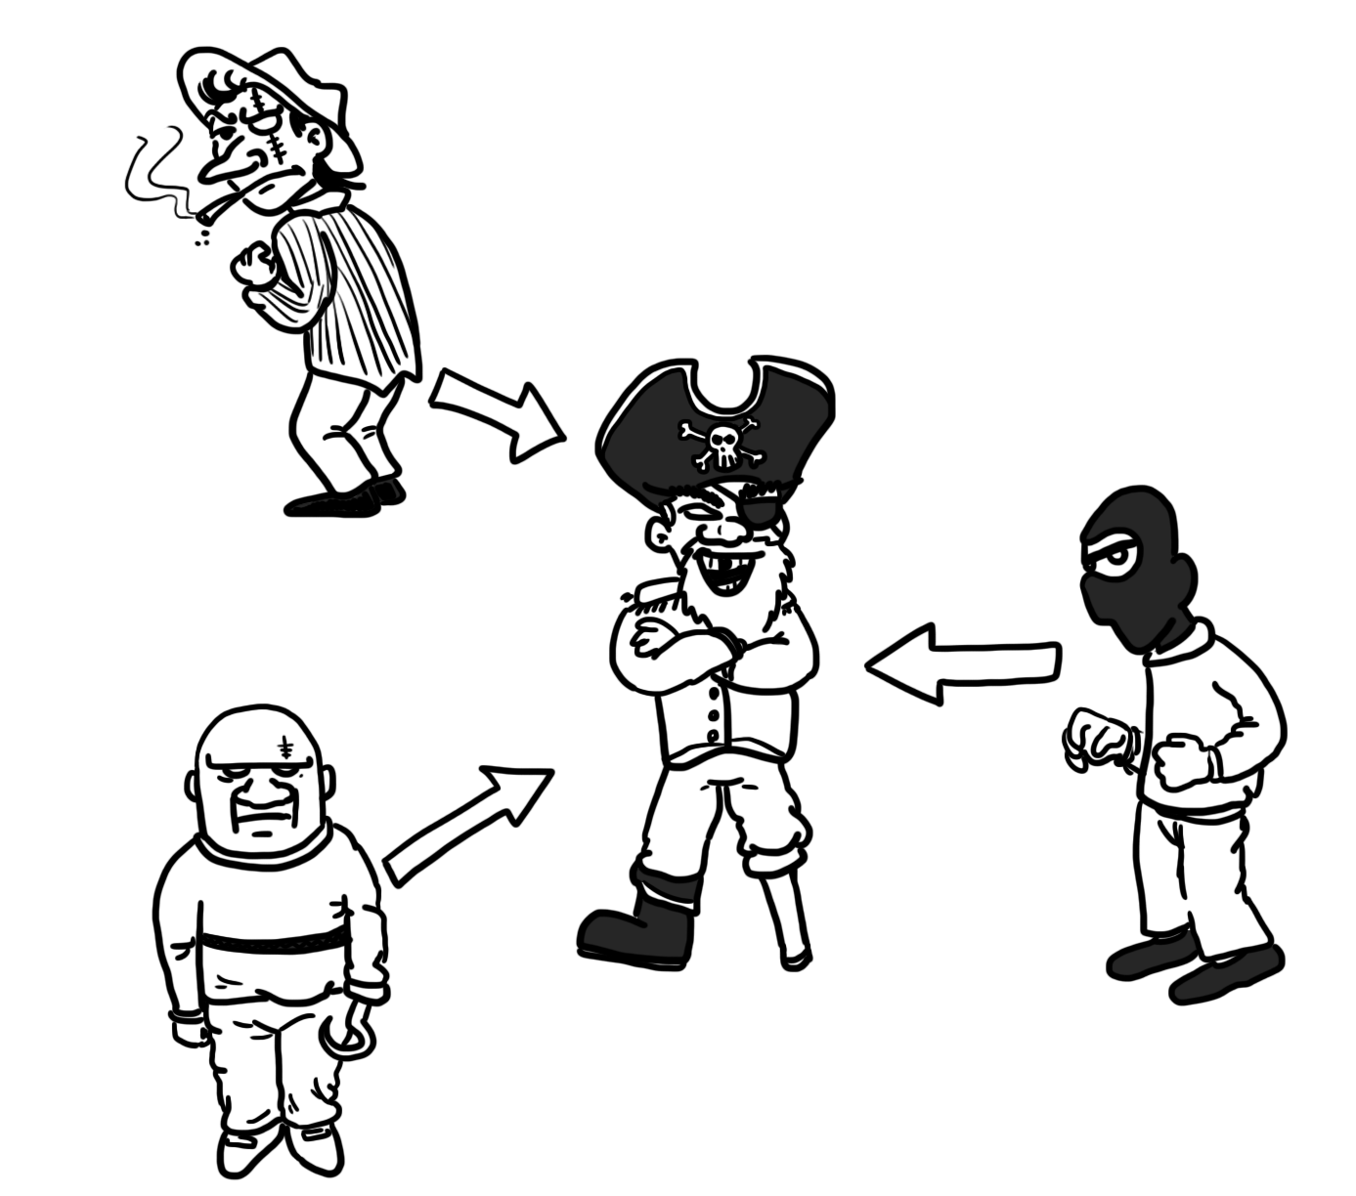
Using hyperlinks to rank web pages (2)
Prestige in social networks: recommendations from (or relationship with) high-rank individuals (above) are more effective to reach a high rank than recommendations by low-rank ones (below).

Slide 5
Using hyperlinks to rank web pages (3)
After a seminal paper by Marchiori about the importance of hyper-information (information in the hyperlinks), Larry Page and Sergey Brin developed the PageRank algorithm
Same social networks principles, by substituting “recommendations” and “citations” with hyperlinks

Slide 6
Using hyperlinks to rank web pages (4)
The prestige of a page is related to how many pages of prestige link to it.
Note the recursive definition: to calculate the prestige, one needs to start from prestige values of other pages, and so on…
Start with initial prestige values (random?) and iterate, if prestige values converge the problem is solved.

Slide 7
Using hyperlinks to rank web pages (5)
What guarantee that the process converges, hopefully to the same limiting distribution, not depending on the initial distribution of values?
The solution to this problem is related to basic linear algebra concepts of eigenvalues and eigenvectors, as well as Markov chains.

Slide 8
Using hyperlinks to rank web pages (6)
Let’s use linear definitions
To calculate rank of a page:
  Examine incoming links (the hyperlinks of other pages pointing to the given page).
  Each incoming link from page i contributes an addendum equal to the rank of i divided by the number of i’s outgoing links

Slide 9
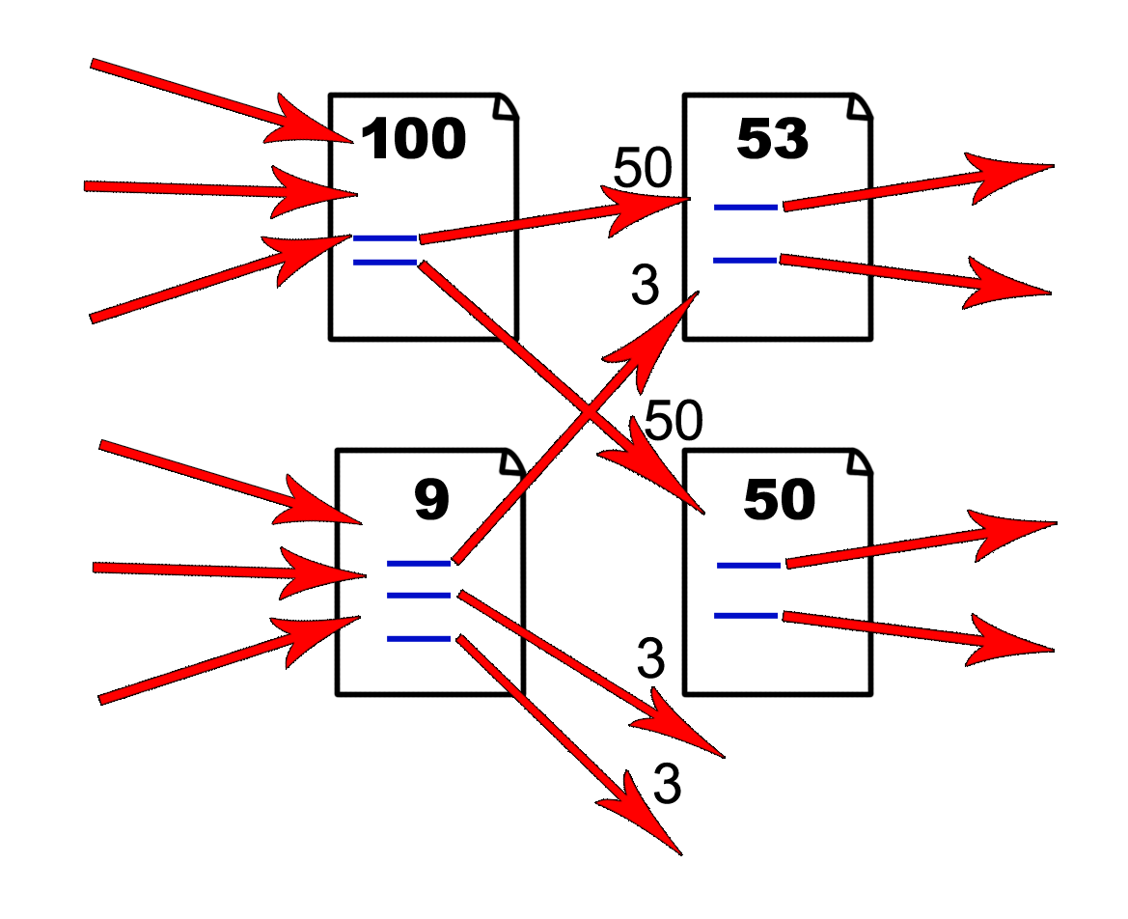
Using hyperlinks to rank web pages (7)
Recalculating the rank of a page in PageRank. The initial rank is
distributed along the outgoing links (adapted from the original paper).

Slide 10


Using hyperlinks to rank web pages (8)
New rank values pk at iteration k are obtained by a linear transformation of the previous values through a matrix M (derived by analyzing hyperlinks)
After k recalculations:
Matrix power

Slide 11


Using hyperlinks to rank web pages (9)
Assume a basis of eigenvectors of M exists
let be the n eigenvalues, and v1; v2; …; vn the corresponding eigenvectors
M vi = λi vi
λ1 is the dominant eigenvalue, so that |λ1| > |λ j| for j > 1.
The initial vector p0 can be written as a linear combination of the basis vectors:

Slide 12
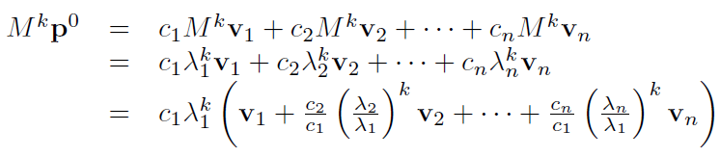
Using hyperlinks to rank web pages (10)
By linearity and definition of eigenvectors:
All terms tends to zero apart from the one proportional to the dominant eigenvector.
A simple iteration of matrix multiplication, after starting from almost arbitrary initial conditions extracts the dominant eigenvector!
Power method for obtaining the dominant eigenvector by the power of a matrix: M^{k})
0
0

Slide 13




A surprising connection with web surfing
Modeling the movement of a web surfer on the various web pages
Let E be the adjacency matrix of the web:
if and only if there is a
link from page u to page v.
What is the probability of the surfer being at page v after one step?
Let be the out-degree of page u
After defining

Slide 14



A surprising connection with web surfing (2)
One obtains:
After i steps: (again, iteration of matrix multiplication)
If E is irreducible and aperiodic, p converges to the largest eigenvector
the prestige (rank) of a page can be interpreted also as probability that a random surfer following links will be found at a given page

Slide 15
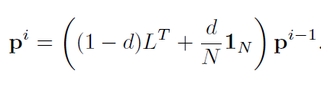
A surprising connection with web surfing (3)
Real-world transition matrices: Web is not strongly connected, and that random walks can be trapped into cycles.
“damping factor” corresponding to a user with an arbitrary probability d of going to a random page (even unconnected) at every step
The transition becomes (1 is the identity matrix)

Slide 16
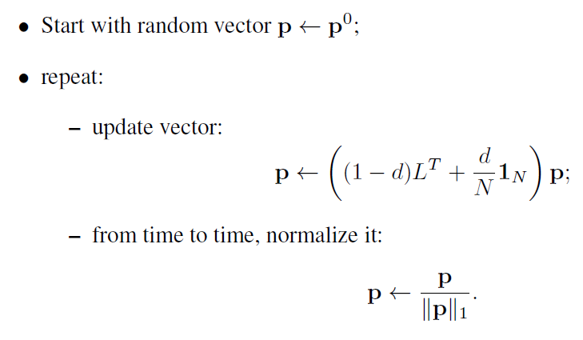
A surprising connection with web surfing (4)
The eigenvector corresponding to the largest eigenvalue can be obtained:
Normalization to avoid very large components and numerical problems. One is not interested in absolute prestige values but in relative ones

Slide 17

Identifying hubs and authorities: HITS
A different analysis of the web. In a scientific community good articles are either seminal (i.e., many others reference to them) or surveys (i.e., they reference to many others).
In the web. pages may be authorities or hubs. For example portals are very good hubs.
Two score measures, called hubness and authority:

Slide 18

Identifying hubs and authorities: HITS (2)
HITS algorithm (Hyperlink-Induced Topic Search)
Given query q, let Rq be the root set returned by an IR system. The computation is performed only on this result set.
The expanded set is formed by adding all nodes linked to the root set:
Let Eq be the induced link subset, Gq = (Vq;Eq).

Slide 19
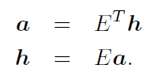
Identifying hubs and authorities: HITS (3)
Authority and hub values are defined in terms of one another
hub score hu proportional to sum of referred authorities, authority score au proportional to the sum of referring hubs

Slide 20
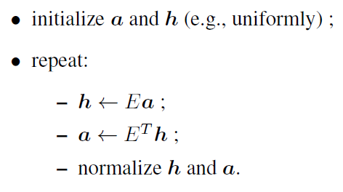
Identifying hubs and authorities: HITS (4)
The iterated method in HITS:
The top-ranking authorities and hubs are reported to the user.
The principal eigenvector identifies the largest dense bipartite subgraph.

Slide 21
Clustering in web mining
During web search, to avoid overloading the user, identify groups of closely related documents, show only a small number of representative prototypes.
Queries can be ambiguous. For example, star: movie stars, or celestial objects?
Mutual similarities in term vector space can help clustering.

Slide 22
Clustering in web mining (2)
Retrieved pages can be characterized either internally by some intrinsic property (e.g., terms contained, coordinates in TF-IDF space) or externally by a measure of distance between pairs. Examples are: Euclidean distance, dot product, Jaccard coefficient.
After defining the metric, the usual bottom-up or top-down clustering techniques can be used (see chapter on clustering).

Slide 23
Gist
The Web is a vast expanse of data, some of it structured, some partially structured or not at all.
Crawling and indexing are systematic methods to visit web pages, harvest the information contained therein and prepare data structures for searching, information retrieval and ranking.
By transforming text into vectors of data (e.g., frequencies of selected words as in the vector-space model) some traditional ML techniques can be reused, but the richer amount of structure in web documents permits amore focused analysis.

Slide 24
Gist (2)
Web-mining find explicit relationships between documents (web links), infer implicit ones (by clustering), rank the most relevant pages or identify the most relevant and well-connected persons in a network of people.
Abstraction helps to use similar tools for networks of pages and networks of people. As a notable example, the use of hyperlinks and linear algebra tools (eigenvectors and eigenvalues), previously used to rank researchers in bibliometrics, leads to a very powerful technique to rank web pages, now at the basis of Google search-engine technology.

