Slide 1

Roberto Battiti, Mauro Brunato.
The LION Way: Machine Learning plus Intelligent Optimization.
LIONlab, University of Trento, Italy,
Apr 2015
http://intelligent-optimization.org/LIONbook
© Roberto Battiti and Mauro Brunato , 2015,
all rights reserved.
Slides can be used and modified for classroom usage,
provided that the attribution (link to book website)
is kept.

Slide 2
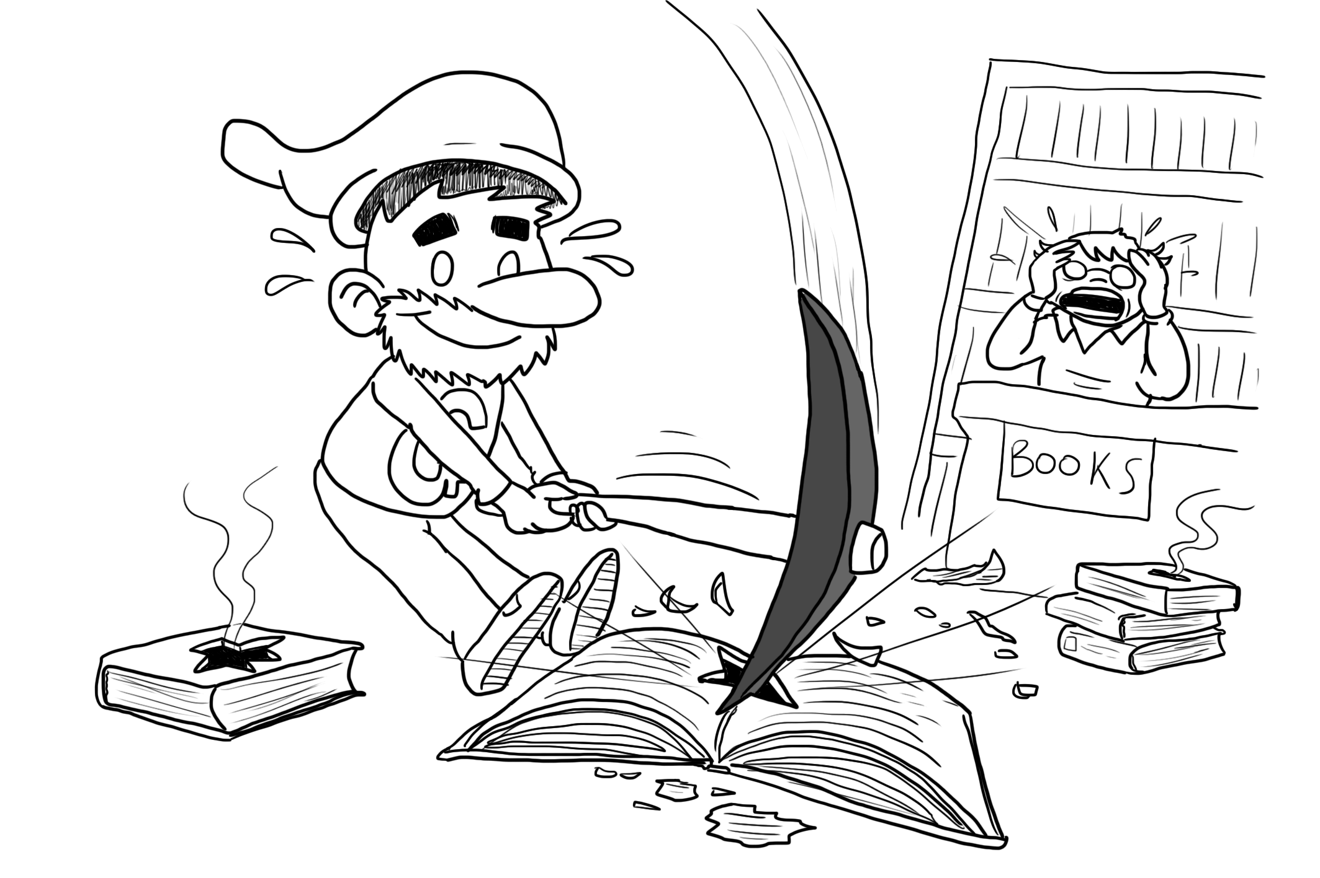
Text and web mining – part I
Wholly new forms of encyclopedias will appear, ready made with a mesh of associative trails running through them, ready to be dropped into the memex and there amplified.
(Vannevar Bush, 1945)

Slide 3
HTML – the language of the web
<html>
<head>
<title>Learning and Intelligent Optimization</title>
<meta name="author" content="Roberto Battiti”/>
<meta name="keywords”
content="LION, ML, optimization, big data”/>
</head>
<body>
<h1>The LION way is the future</h1>
The reasons are explained in the
<a href=”http://intelligent-optimization.org/”>LIONlab
homepage </a>.
</body>
</html>

Slide 4
HTTP – the protocol of the web
GET /thispath/thispage.html HTTP/1.1
Accept: */*
Accept-Language: it-it
Accept-Encoding: gzip, deflate
User-Agent: Mozilla/5.0 (Macintosh; U; PPC Mac OS X; it-it)
AppleWebKit/418.9.1 (KHTML, like Gecko) Safari/419.3 Connection: keep-alive
Host: www.pippo.it
Connect to well-known TCP port 80

Slide 5
What is web mining?
The Web is an unstructured (or, at most, semi-structured) collection of data.
Data come in form of human-readable texts and images. Data are hyperlinked.
The Web is not a database
  A complete description of data items (a schema) is missing.
  Every word on a page can be an attribute
The Web is a collection of human-readable data and human-exploitable hyperlinks.

Slide 6
Crawling the web
One common need of hypertext processing: the ability of fetching and storing a large number of documents.
Crawlers, Spiders, Web Robots, Bots
Common examples:
  wget
  curl

Slide 7
Basic crawling principles
Start from a given set of URLs.
Collect pages.
Scan collected pages for hyperlinks to pages that have not been collected yet.
New URLS are potential new work and their set increases very fast.

Slide 8
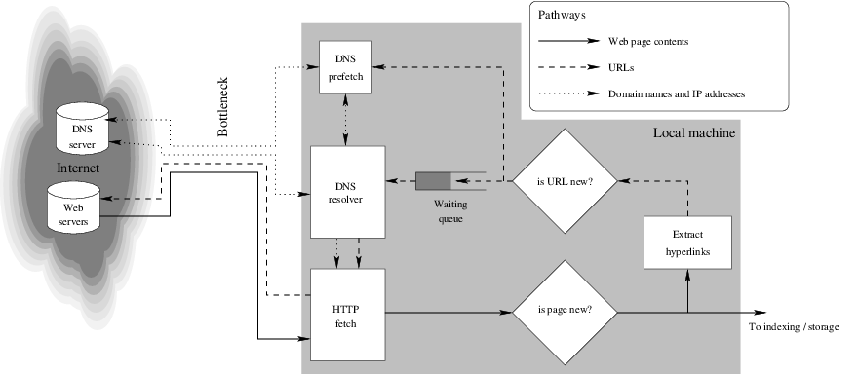
A large-scale crawler

Slide 9
A large-scale crawler
A single page fetch involves seconds of latency (⇒ More fetches at the same time).
Highly concurrent DNS (possibly multiple servers).
No multithreading, better asynchronous sockets.
Avoid duplicate URLs.

Slide 10
A large-scale crawler:
DNS usage
Crawler access is often spread through different domains to avoid overloading web servers (but being more demanding to DNS servers).
Cache can be slack with expiration times: better expired than late.
Problem:
  Standard DNS service in the OS does not handle concurrent requests, so a custom DNS client is necessary (asynchronous sending and receiving).
Better solution: prefetching — do not wait for page request, but extract potential DNS queries from current pages.

Slide 11
A large-scale crawler: concurrent page fetches
Web-scale crawlers fetch > 105 pages per second. Page retrievals must proceed in parallel.
Two approaches:
  Exploit OS-level multithreading (one thread per page).
  Use non-blocking sockets and event handler.
What about multiprocessors?
  Bottlenecks are network and disks, not CPU.

Slide 12
A large-scale crawler: multithreading
Multiple threads, statically created to avoid overhead. Call to connect(), send() or recv() may block one thread while others run.
Pros
  Easy coding, complexity delegated to OS
Cons
  Synchronization problems and consequent IPC overhead
  Hardly optimized (OS assumes general purpose)
  One disaster spoils all threads (better with processes)

Slide 13
A large-scale crawler: non-blocking sockets
Single thread, arrays of non-blocking sockets, using select() to poll for received data.
While doing other business (indexing, saving to disk) incoming data are buffered until the next polling cycle.
Pros
  Fast, little overhead from OS
  Better control on overall status
  No need of protection or synchronization.
Cons
  Harder to code: need multiple data structures.

Slide 14
A large-scale crawler: link extraction
Web pages are parsed for hyperlinks. URLs must be canonicalized:
www.pippo.com/here/not/../there#this
⇓
http://www.pippo.com:80/here/there/
Problems
  Domain name - IP address relationship is many-to-many, due to load balancing needs and logical website mapping.

Slide 15
A large-scale crawler: avoiding repeated visits
Visited URLs must be stored to avoid unneeded duplicate visits: need of a fast memory-based isUrlVisited? function.
To save space, URLs are hashed, commonly by 2-level functions to exploit locality: (hostname,path).

Slide 16
A large-scale crawler: manage robot exclusion
robots.txt usually helps crawlers avoid useless portions of a website
User-agent: LIONcrawler
Crawl-delay: 1000
Disallow: /this/path
Disallow: /that/directory
User-agent: *
Disallow: /secrets
Disallow: /dynamic/page
Disallow: /ever/changing/path

Slide 17
A large-scale crawler: avoid spider traps
Some web sites can be maliciously designed in order to crash spiders:
  Recursive links via soft aliases.
  Long URLs to overflow lexers and parsers.

Slide 18
A large-scale crawler: per-server queues
Web servers need to safeguard against DoS attacks.
Crawlers must limit frequency of requests to the same server
Span many different servers at once, but no more than n pages per second each (problem: DNS overload).
Use queues.

Slide 19
Document indexing: queries
The simplest kind of query involves relationships between terms and documents:
  Documents containing the word “java”
  Documents containing the word “java” but not “coffee”
Proximity queries require the use of inverted indices.
  Documents containing the phrase “java beans” or the word “API”
  Documents where “java” and “island” occur in the same sentence.

Slide 20
Document indexing: operations on text
filter out HTML tags
tokenization
  simplest case: tokens are all nonempty sequences of characters not including spaces or punctuation marks.
stopword removal
downcasing
stemming
  PLAYS PLAYING PLAYED REPLAY -> PLAY
collapse variant forms (“am”, “is”, “are” all become “be”)
...But beware the loss of information!

Slide 21
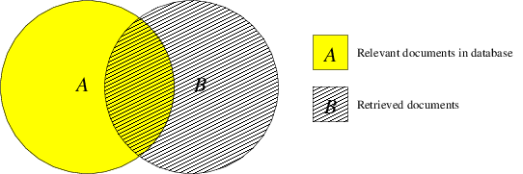
Information Retrieval:
Performance measures
Retrieved relevant items (true positives): A∩B
Retrieved irrelevant items (false positives): B∖A
Unretrieved relevant items (false negatives): A∖B
Which fraction of retrieved documents is relevant?
Precision =
Which fraction of relevant documents has been retrieved?
Recall =

Slide 22
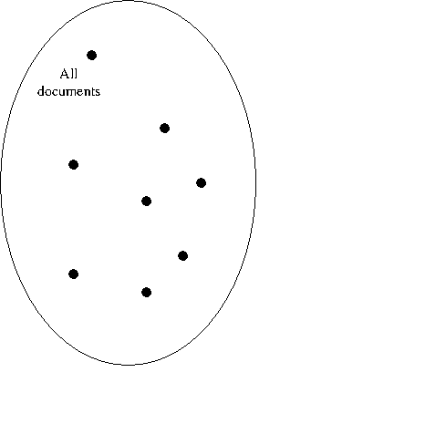
Document ranking: intuition

Slide 23
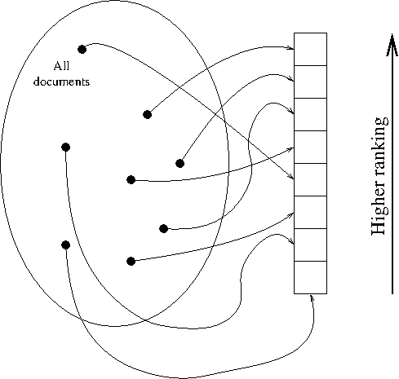
Document ranking: intuition

Slide 24
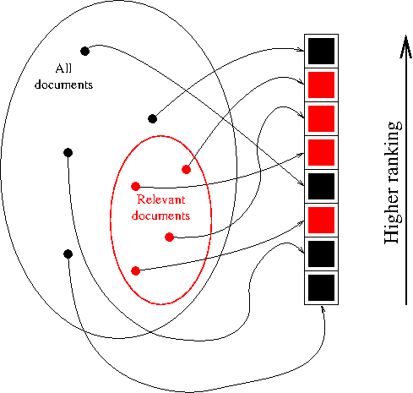
Document ranking: intuition

Slide 25
Document ranking: intuition
Red blocks
should appear
at the top!

Slide 26
Precision and recall w/ ranking
D: corpus of n = |D| documents; Q: set of queries.
For query q∈Q, define D_{q}⊂D as the set of all relevant documents (exhaustive, manually defined).
Let (d₁^{q}, d₂^{q}, ... , d_{n}^{q}) be an ordering (“ranking”) of D returned by system in response to query q.
Let (r₁^{q}, r₂^{q}, ... , r_{n}^{q}) be defined as

Slide 27
Precision and recall w/ ranking
Recall(k): fraction of relevant documents found in the top k positions
Precision(k): fraction of top k documents that are relevant

Slide 28
Precision and recall w/ ranking
Average precision

Slide 29
Precision / recall tradeoff
Average precision is 1 iff all relevant documents are ranked before irrelevant ones
Interpolated precision at recall = ρ: maximum precision for recall greater or equal to ρ.
By convention, precision_{q}(0) = 1 and recall_{q}(0) = 0.
Recall can be increased by increasing k, but then more and more irrelevant documents occur, driving down precision.
Therefore, a recall-precision plot has a downward slope.

Slide 30
Precision / recall tradeoff
“Interpolated precision”
  Answering the question “What is the best precision I can get for a recall score no smaller than r?”
Stepwise constant, non-increasing function of recall rate.

Slide 31
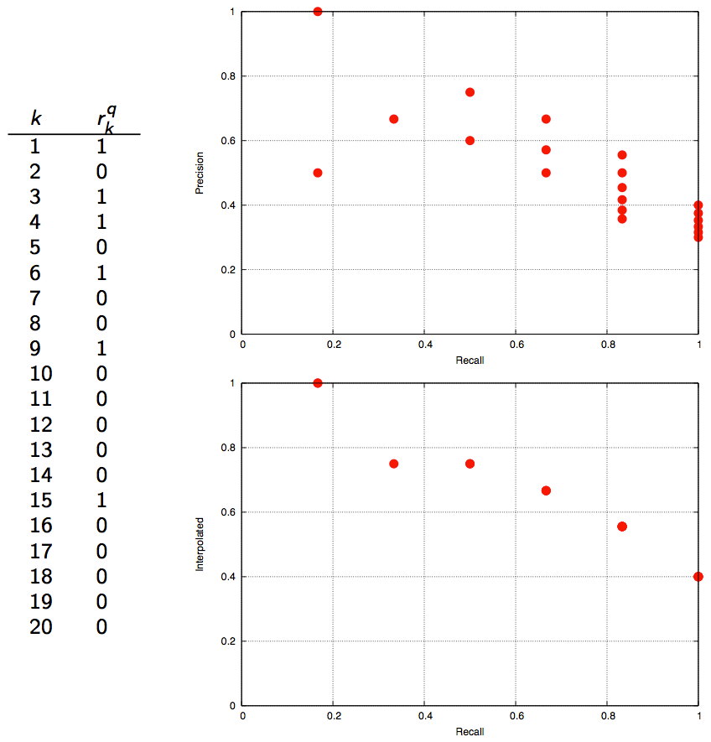
Precision / recall tradeoff
= non-dominated points
(in the Pareto sense)
= interpolated precision

Slide 32
The vector-space model
Representing document as points in a multi-dimensional space, each axis representing a term (token).
Coordinate of document d in direction of term t determined by:

Slide 33
The vector-space model
Inverse document frequency:
  rewards rare terms, small for frequent terms
  smooth, slow growth

Slide 34
The vector-space model
Document d is represented by vector
where component d_{t} is
A query is a sequence of terms, therefore it has the same representation.

Slide 35
Proximity between documents
Euclidean distance: to avoid artifacts, vectors should be normalized: an n-fold replica of document d should have the same similarity to q as d itself.

Slide 36
Proximity between documents
Cosine similarity: cosine of the angle between vectors d and q.

Slide 37
TFIDF-based IR system
Information Retrieval system based on TFIDF coordinates:
  Build inverse index with TF(t,d) and IDF(t) information
  Given a query, map it onto TFIDF space
  Sort documents according to similarity metric
  return most similar documents
Now we are ready to refine the search!

Slide 38
Relevance feedback
The average web query is as few as two terms long!
After the first response, a sophisticated user learns how to improve his query.
For everybody else. . .
  Results page may include a rating form for documents (“Please mark documents that you have found useful”)
  User’s form submission is a form of relevance feedback.

Slide 39
Relevance feedback:
Rocchio’s method
Correct query q by pushing it closer to a set of useful documents D₊ and pulling it apart from a set D₋ of useless docs:
Parameters α, β and γ control the amount of modification.

Slide 40
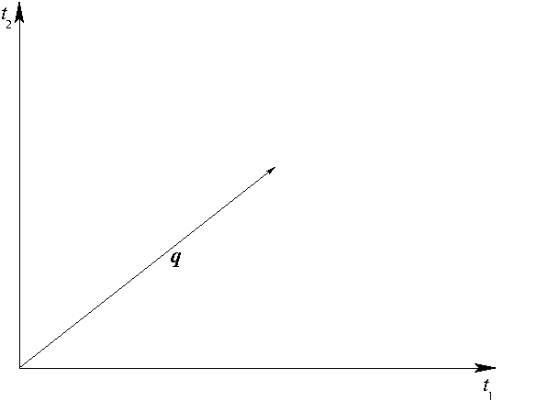
Relevance feedback:
Rocchio’s method

Slide 41
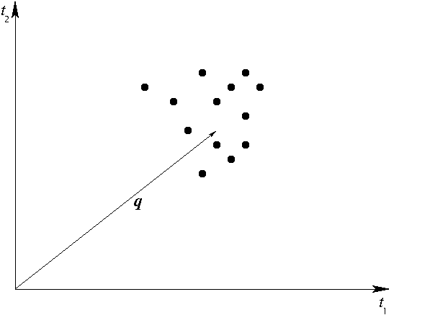
Relevance feedback:
Rocchio’s method

Slide 42
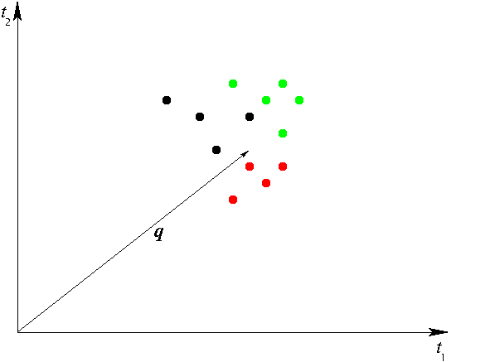
Relevance feedback:
Rocchio’s method

Slide 43
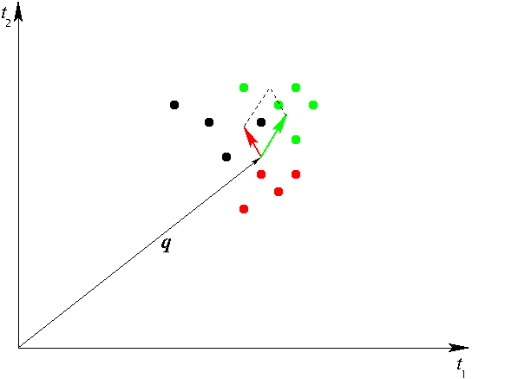
Relevance feedback:
Rocchio’s method

Slide 44
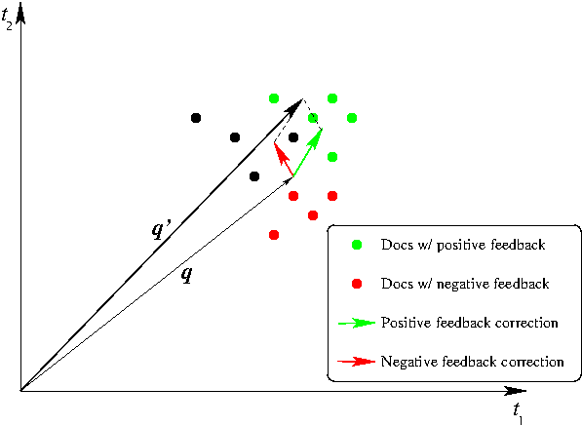
Relevance feedback:
Rocchio’s method

Slide 45
Relevance feedback:
Rocchio’s method
If user input is absent:
  Automatically build D₊ by assuming that a certain number (e.g., 10) of highest-ranked documents are more relevant than others.
One bad word may spoil it all
  Not all terms in documents in D₊ and D₋ should be used in the formula.
  E.g., for every document in D₊ and D₋ only take the 10 terms with the highest IDF index.

Slide 46
Documents as sets
Another, simpler, representation of documents: sets of terms
  even less information retained: no term order, no term proximity, no term count.
  “Bag of words” can refer to this representation (but is often associated to multiset representation, where elements retain count information)

Slide 47
Similarity of sets
Jaccard coefficient: number of common elements (intersection), normalized by overall size (union):
Similarity measure, ranging from 0 to 1.
0 if sets are disjoint, 1 if sets are equal.
1-r’(A,B) is a metric.

Slide 48
Approximating the Jaccard coefficient
Even with the most efficient set representation, computing the Jaccard coefficient is linear in the set size.
Computing Jaccard coefficients between all pairs of documents in a corpus has therefore a high time complexity:
where m is the number of documents (millions?) and |d| is the average document size (thousands?).

Slide 49
Approximating the Jaccard coefficient
Observation:
So we can approximate the Jaccard coefficient by picking random elements in the union and counting how many belong to both sets.

Slide 50
Approximating the Jaccard coefficient
To do it efficiently: let π be a random permutation on T (the set of terms). Then:
is a uniformly chosen term in the union.
The term t also belongs to the intersection if and only if

Slide 51
Approximating the Jaccard coefficient
Precompute N permutations π₁,...,π_{N} of term set;
for all document ids i=1,...,m and for all permutations, compute
for all pair of documents (d_{i},d_{j}), just let
i.e., the frequency of permutations that end up to the same minimum.
Complexity is significantly reduced:

