Slide 1
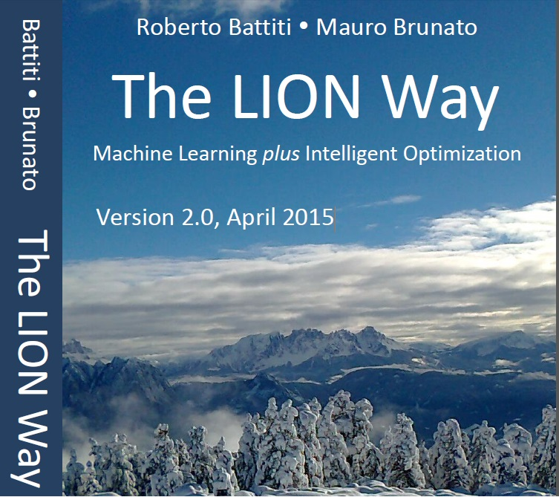
Roberto Battiti, Mauro Brunato. The LION Way: Machine Learning plus Intelligent Optimization. LIONlab, University of Trento, Italy,
Apr 2015
http://intelligent-optimization.org/LIONbook
© Roberto Battiti and Mauro Brunato , 2015,
all rights reserved.
Slides can be used and modified for classroom usage,
provided that the attribution (link to book website)
is kept.

Slide 2
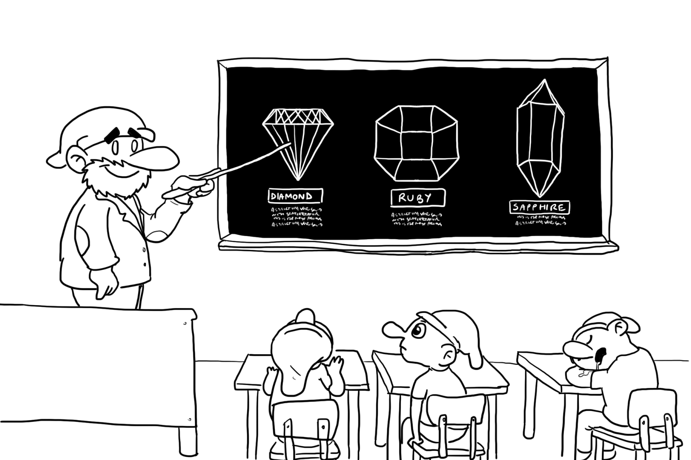
Chap.2 Lazy learning: nearest neighbors
Natura non facit saltus
Nature does not make jumps

Slide 3
Learning from examples
written characters (“a”,“b”,“c”. . . )
labeled examples
Memorization is different from extracting the underlying patterns and regularities
Generalization is the key

Slide 4
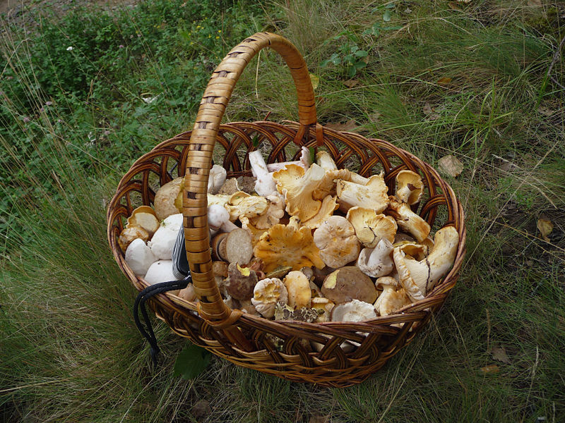
Learning from examples
Mushroom hunting requires classifying edible and poisonous species.

Slide 5
Learning from examples
In supervised learning a system is trained by a supervisor (teacher) giving labeled examples.
Each example is an array, a vector of input parameters x called features with an associated output label y.

Slide 6
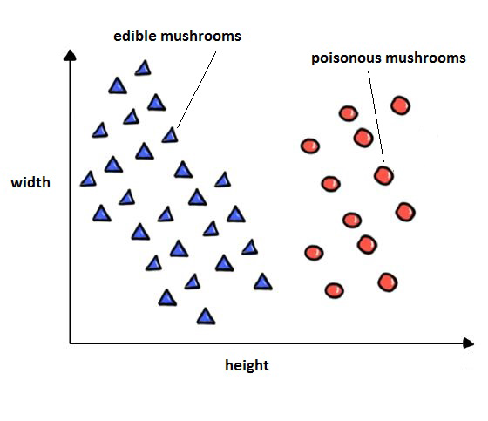
Lazy “nearest neighbor” method of machine learning.
Lazy beginners in mushroom picking

Slide 7
Nearest-Neighbors Methods
nearest-neighbors basic form of learning, also related to instance-based learning, case-based or memory-based, pattern patching
Classify a new example according to the nearest neighbor (considering input values)

Slide 8
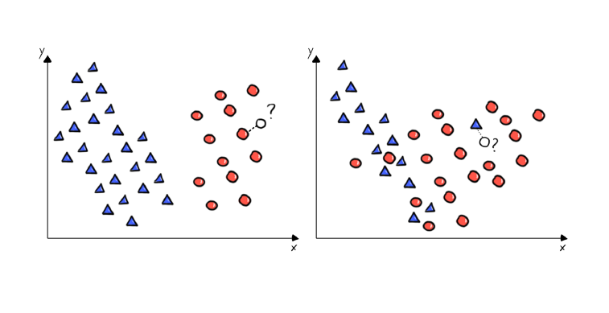
Neighbor → Neigbors
k-nearest-neighbors (KNN)
Majority or unanimity rule

Slide 9
Regression
regression (the prediction of a real number, like the content of poison in a mushroom), the output can be obtained as a simple average

Slide 10
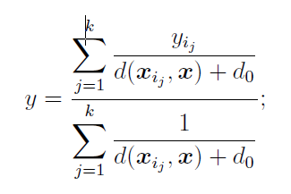
Weighted K-nearest neighbors (WKNN)
Closer neighbors receive a higher weight (and more influence to derive the output value)

Slide 11
Kernels and locally weighted regression
Kernel methods and locally-weighted regression can be seen as flexible and smooth generalizations of the nearest-neighbors idea
Instead of applying a brute exclusion of the distant points, all points contribute to the output but with a significance (“weight”) related to their distance from the query point.

Slide 12
Gist
KNN (K Nearest Neighbors) is a primitive and lazy form of machine learning: just store all training examples into memory.
When a new input to be evaluated appears, search in memory for the K closest examples stored. Read their output and derive the output for the new input by majority or averaging. Laziness during training causes long response times when searching a very large memory storage.
KNN works in many real-world cases because similar inputs are usually related to similar outputs, a basic hypothesis in machine learning. It is similar to some “case-based” human reasoning processes. Although simple and brutal, it can be surprisingly effective in many cases.

