Slide 1

Roberto Battiti, Mauro Brunato. The LION Way: Machine Learning plus Intelligent Optimization. LIONlab, University of Trento, Italy,
Apr 2015
http://intelligent-optimization.org/LIONbook
© Roberto Battiti and Mauro Brunato , 2015,
all rights reserved.
Slides can be used and modified for classroom usage,
provided that the attribution (link to book website)
is kept.

Slide 2

Local Search and Reactive Search Optimization (RSO)
Everybody carries on his shoulders the responsibility of his choices. It is a nice weight.
(Romano Battiti)

Slide 3
Brute force is not the solution
Let’s assume that one has to find the minimum of a discrete (combinatorial) optimization problem (for example, think about the travelling salesman problem)
Evaluating all possible combinations of inputs can be computationally impossible
One needs to resort to clever techniques to solve these problems

Slide 4
Local search based on perturbations
starting from an initial tentative solution
try to improve it through repeated small changes
stop when no improving local change exists
(local optimum, or locally optimal point)

Slide 5
Local search optimization: notation
χ is the search space
X^{(t)} is the current solution at iteration t.
N( X^{(t)}) is the neighborhood of point X^{(t)}, obtained by applying a set of basic moves μ₀,…, μ_{M} to the current configuration

Slide 6
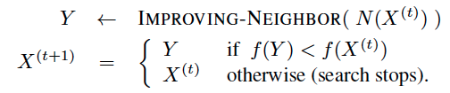
Local search optimization
Local search starts from an admissible configuration X⁽⁰⁾ and builds a trajectory X⁽⁰⁾,…,X^{(t+1)}.
The successor of the current point is constructed as follows
IMPROVING -NEIGHBOR returns an improving element in the neighborhood

Slide 7
Local optima are not always global optima
For many optimization problems, a closer approximation to the global optimum is required
More complex search schemes have to be adopted to balance in an optimal way exploration and exploitation

Slide 8
Attraction basins
Local minima tend to be clustered (good local minima tend to be closer to other good minima)
The attraction basin associated with a local optimum is the set of points X which are mapped to the given local optimum by the local search trajectory
if local search stops at a local minimum, kicking the system to a close attraction basin can be much more effective than restarting from a random configuration

Slide 9
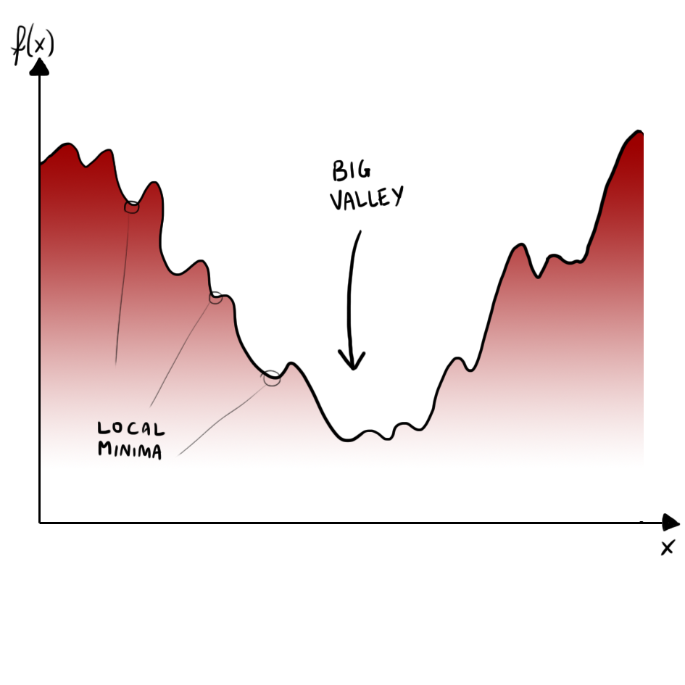
Structure in optimization problems: the “big valley” hypothesis.

Slide 10
Modifications of local search based on perturbations
local search by small perturbations is an effective technique but additional ingredients are in certain cases needed to obtain superior results

Slide 11

Local search in action: how to build a better bike, from the initial model
(left) to a worse variation (middle), to the final and better configuration (right).

Slide 12
Reactive Search Optimization (RSO): Learning while searching
Many problem-solving methods are characterized by a certain number of choices and free parameters, usually manually tuned.
Parameter tuning can be automated as a part of the optimization algorithm
This leads to self-contained, fully automated algorithms, independent from human intervention
Reactive Search Optimization (RSO) integrates online machine learning techniques and search heuristics for solving complex optimization problems.

Slide 13
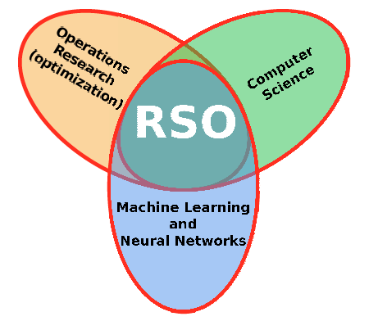
Reactive Search Optimization (RSO):
RSO is a the intersection of optimization, computer science (algorithms and data structures) and machine learning.

Slide 14
Reactive Search Optimization
RSO can be applied to systems that require to set some operating parameters to improve its functionality.
A simple loop is performed: set the parameters, observe the outcome, then change the parameters in a strategic and intelligent manner until a suitable solution is identified
In order to operate efficiently, RSO uses memory and intelligence to improve solutions in a directed and focused manner

Slide 15
Reactive Search Optimization
While many alternative solutions are tested in the exploration of a search space, patterns and regularities appear
The human brain quickly learns and drives future decisions based on previous observations.
This is the main inspiration source for inserting online machine learning techniques into the optimization engine of RSO

Slide 16

Algorithms with self-tuning capabilities like RSO make life simpler for the final user. Complex problem solving does not require technical expertise but is available to a much wider community of final users

Slide 17
RSO based on prohibitions: tabu search
Basic idea: using prohibitions to encourage diversification
How?
While constructing a trajectory for local minima search, every time a move is applied, the inverse move is temporarily prohibited

Slide 18
Tabu search: an example
Let χ={0,1}^{L}
The neighborhood is obtained by applying the elementary moves μ_{i}, (i = 1,…,L) that change the i -th bit of the string X = [x₁,…, x_{i},…, x_{L}]
At each step, the selected move is the one that minimizes the target f in the neighborhood even if f increases, to exit from local minima.
As soon as a move is applied, the inverse move is temporarily prohibited

Slide 19
Tabu search
Tabu search can generate cycles. For example, if the current point X^{(t)} is a strict local minimum
In general, the inverses of the moves executed in the most recent part of the search are prohibited for a period T, in order to avoid cycles and to diversify

Slide 20
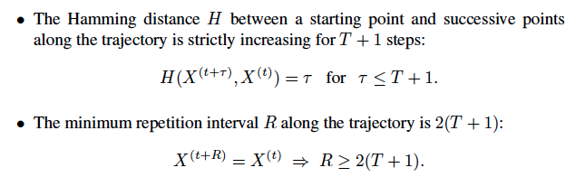
Prohibition and diversification
Let H(X, Y ) be the Hamming distance between two strings X and Y
if only allowed moves are executed, and T satisfies T < (n - 2) (at least two moves are allowed at each iteration), then

Slide 21
Prohibition and diversification(2)
prohibition is related to the amount of diversification :
the larger T , the larger is the distance H that the search trajectory must travel before it is allowed to come back
If T is too large, the number of allowed moves will shrink, leading to less freedom of movement.

Slide 22
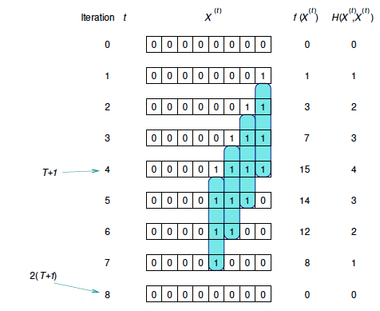
An example of the relationship between prohibition T , and diversification
measured by the Hamming distance H(X(t);X(0)) . T = 3 in the example

Slide 23
Tuning the T parameter
The parameter T should be tailored to the specific problem
BUT the choice of a fixed T without a priori knowledge is difficult
RSO uses a simple mechanism to change T during the search so that the value T^{(t)} is appropriate to the local structure of the problem
RSO determines the minimal prohibition value which is sufficient to escape from an attraction basin around a minimizer

Slide 24
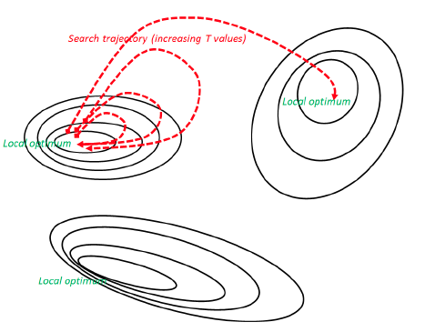
RSO with prohibitions in action. Three locally optimal points are shown together with contour lines of the function to be optimized. When starting from a locally optimal point, RSO executes loops which reach bigger and bigger distances from the attractor, until another attraction basin is encountered (if present).

Slide 25
RSO for tabu search
T is equal to one at the beginning
T increases if the trajectory is trapped in an attraction basin
T decreases if unexplored search regions are visited, leading to different local optima

Slide 26
RSO: conclusions
If the problem has a single local optimum the power of RSO is not needed, although not dangerous
Most real-world problems are infested with many locally optimal points
RSO is crucial to transform a local search building block into an effective and efficient solver.
RSO with prohibitions has been used for problems ranging from combinatorial optimization to the minimization of continuous functions and to sub-symbolic machine learning tasks

Slide 27
GIST
Local search is a simple and very effective way to identify improving solutions for discrete optimization problems
It generates a sequence of changes, each change being local
Local search stops at locally-optimal points and the current search trajectory is trapped
Additional diversification means are needed to escape from local attractors.

Slide 28
GIST (2)
Reactive Search Optimization (RSO) uses learning and adaptation during the optimization process, to fine-tune the search technique to the current problem, task and local properties.
An intelligent module overseeing the basic local search process
It automatically balances diversification and intensification

