Slide 1

Roberto Battiti, Mauro Brunato. The LION Way: Machine Learning plus Intelligent Optimization. LIONlab, University of Trento, Italy,
Apr 2015
http://intelligent-optimization.org/LIONbook
© Roberto Battiti and Mauro Brunato , 2015,
all rights reserved.
Slides can be used and modified for classroom usage,
provided that the attribution (link to book website)
is kept.

Slide 2

Automated improvements by local steps
In this world - I am gonna walk
Until my feet - refuse to take me any longer
Yes I’ m gonna walk - and walk some more.
(Macy Gray and Zucchero Fornaciari)

Slide 3
Optimization
Most problems can be cast as finding the optimal value for a suitable objective function, subject to constraints
Methods to optimize functions are the source of power for most problem solving and decision making activities
Maximizing = identifying the input values causing the maximum output value

Slide 4


Two related problems: Minimization and root finding
Nonlinear equations problem: solving a set of nonlinear equations
Unconstrained minimization

Slide 5
Optimization and learning
Optimization for learning:
Select, among a class of models, one that is most consistent with the data provided, e.g., minimizing the sum of squared differences
Learning for optimization
Learning is used in optimization algorithms to build local models of the function to be optimized

Slide 6
Derivative-based techniques for optimization in one dimension
Root finding: How does one find a point where a differentiable function f(x) is equal to zero?
Start with a point sufficiently close to the target and iterate the following:
Find a local solvable model
Solve the local model

Slide 7


Newton’s method
Let f(x) be a differentiable function. The local model around a point x_{c} can be derived from Taylor series approximation
A local model around the current estimate x_{c} is therefore

Slide 8
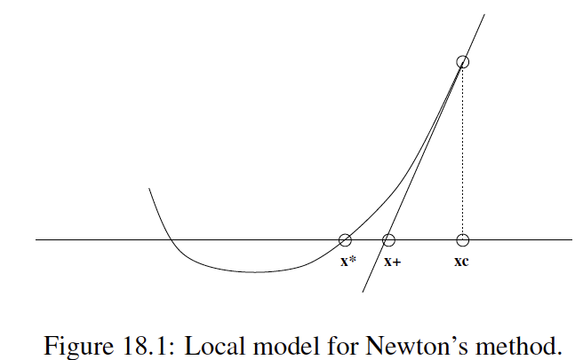
Root finding: Newton’s method

Slide 9

Newton’s method
by finding the root of the model one gets a prescription for the next value x₊ of the current estimate
Iterating the two steps, under some hypothesis, x_{c} converges to the solution

Slide 10


Newton’s method: convergence
The following lemma easily follows from the previous definition

Slide 11
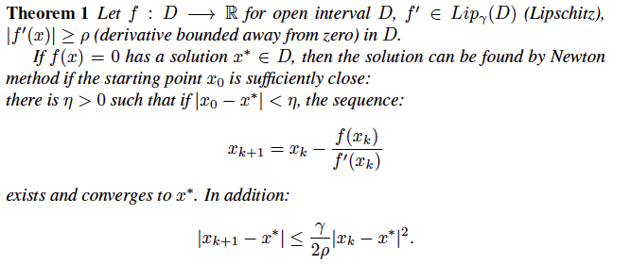
Newton’s method: convergence
Using lemma one, it is easy to proof the following

Slide 12
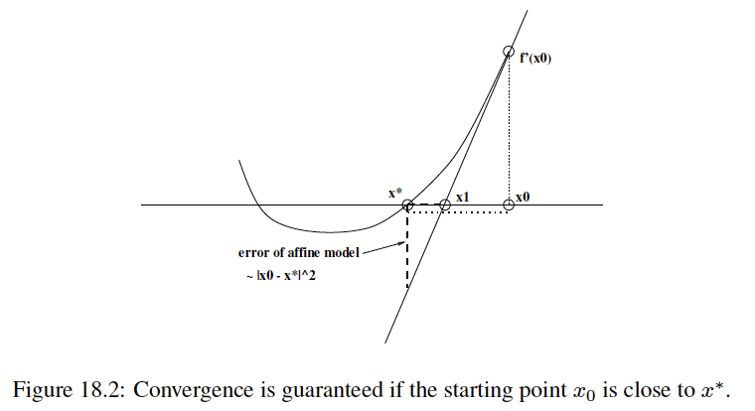
Newton’s method: convergence

Slide 13
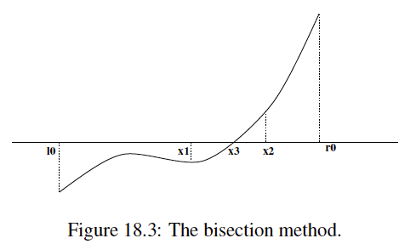
Root finding: Bisection method

Slide 14
Root finding: Bisection method (2)
What if no guarantee of starting sufficiently close? Bisection method is more robust!
subdivide an initial interval into two parts
observe the value at the middle point
continue the search by considering only the left or the right sub-interval

Slide 15
Newton and bisection: pros & cons
1.Newton:
quadratic convergence
only locally convergent
2.Bisection
simple and effective
globally convergent
logarithmic convergence
cannot be extended to higher dimensions
Hybrid methods combine global convergence and fast local convergence

Slide 16
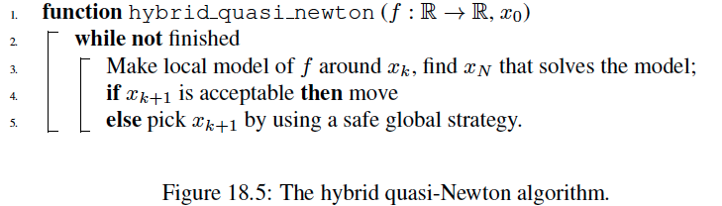
Hybrid methods
Generic scheme: combine global convergence and fast local convergence

Slide 17
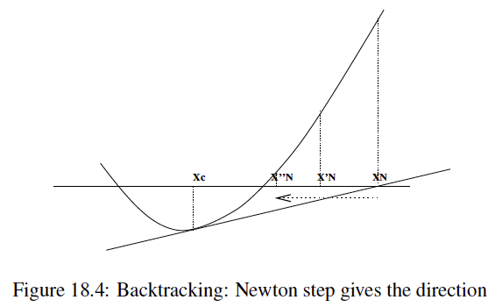
Backtracking
if Newton’s step leads too far, beyond the position of the root, one reverts the direction coming back closer to the root position

Slide 18

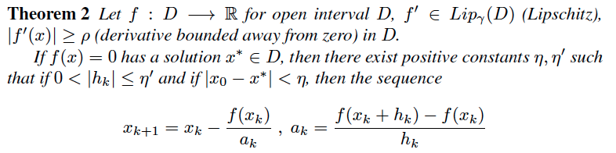
Approximate derivative with secant
If derivatives are not available one can approximate them with the secant:
A convergence theorem is valid:

Slide 19
Minimization of differentiable functions
If a differentiable function f attains a minimum at x* , then f’(x*)=0.
The problem can be reduced to finding a root of the derivative function (necessary condition, but not sufficient)
We know how to do it! (just apply Newton, or bisection, or a hybrid algorithm, to f’)

Slide 20

Solving models in more dimensions
Solving the local quadratic model in higher dimension amounts to solving a quadratic form.
Newton’s method now requires that the gradient of the model be equal to zero.
Given a step s the quadratic model is

Slide 21
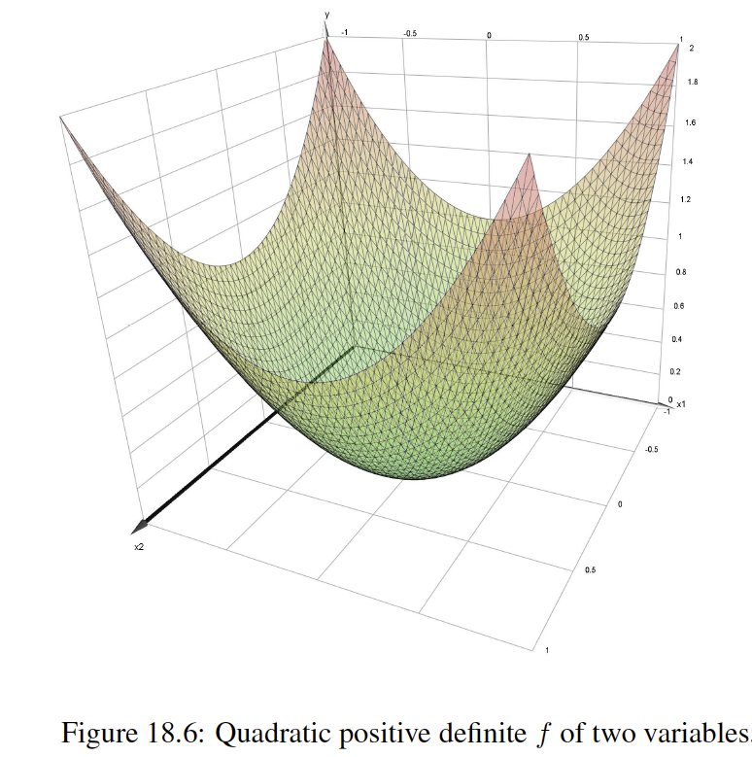
Positive-definite quadratic forms

Slide 22

Solving models in more dimensions(2)
After deriving the gradient, one demands
The solution of the linear system can be found in one step of cost O(n³) for the standard matrix inversion

Slide 23
Numerical instability
computation carried out by computers has to deal with issues of numerical stability
Errors can accumulate in a dangerous way, leading to wrong numerical solutions
The solution can be very sensitive to small changes in the data (ill conditioning)

Slide 24
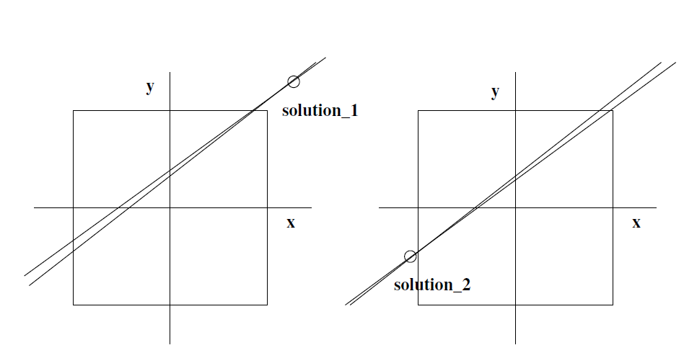
Ill conditioning
Ill-conditioning: solution is very sensitive to changes in the data. In this
case two linear equations are very similar and a small change in the line direction is
sufficient to shift the solution by a large amount.

Slide 25

Quantifying ill-conditioning
The condition number k(H) of a matrix H is defined as ||H|| ||H⁻¹||
k(H) measures the sensitivity of the solution of a linear system to finite-precision arithmetic

Slide 26

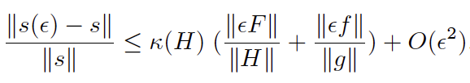
Quantify ill conditioning(2)
If a linear system H x = b is perturbed with an error proportional to ε
the relative error in the solution can be bounded as:

Slide 27

Cholesky factorization
For symmetric and positive definite matrices, Cholesky factorization is an extremely stable way to find a triangular decomposition.
With L lower triangular, D diagonal with strictly positive elements.
Since the diagonal is strictly positive, we can write
where R is a general upper triangular matrix.

Slide 28
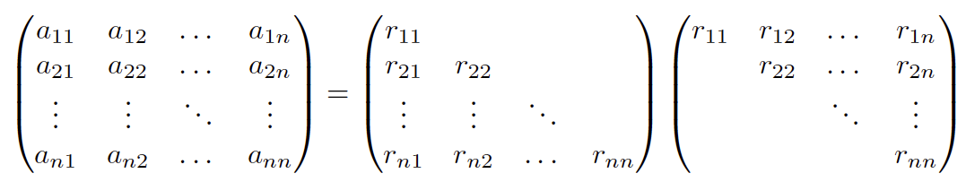
Cholesky decomposition: construction
R can be computed directly from the element-by-element equality:
This process requires 1/6 n³ multiplications and additions and n square roots

Slide 29

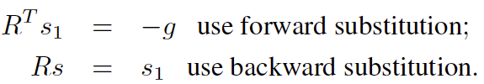
Solving a linear system with Cholesky factorization
Once the Cholesky factorization is available, the original equation becomes
It can be solved by back-substitution
The cost for solving the equation is O(n²) : the dominant cost is in the factorization

Slide 30

Gradient or steepest descent
Two gradient-descent experts on the mountains surrounding Trento, Italy.

Slide 31


Gradient descent
finding the minimum of the quadratic model by matrix inversion is often neither efficient nor robust
steepest descent is a possible strategy to gradually improve a starting solution
moving along the negative gradient, the function decreases for sufficiently small values of the step

Slide 32
Gradient descent: pros & cons
simple to implement
intuitive interpretations (think about a drop of water on a surface, or about a skier)
used in many applications
ε has to be carefully chosen
no global vision is available to guide the search, only local information.
If the matrix is ill-conditioned , the gradient direction does not point towards the optimal value

Slide 33
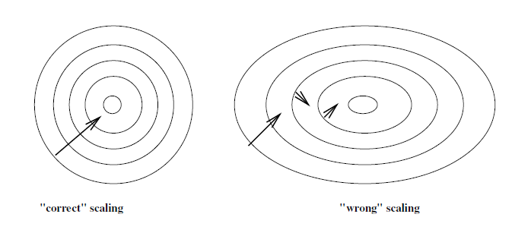
Gradient not always the “best” direction
The gradient is not always an appropriate direction: the trajectory can zig-zag (right figure).

Slide 34

Conjugate gradient
Conjugate gradient method aims at prescribing a set of directions along which one should iteratively optimize the function
Two directions are mutually conjugate with respect to the matrix H if
After minimizing in direction p_{i} , the gradient at the minimizer will be perpendicular to p_{i}
The second minimization is in direction p_{i+1} : the change of the gradient along this direction is g_{i+1} -g_{i} = αHp_{i+1} and it is perpendicular to p_{i}
being the gradient perpendicular to p_{i}, the previous minimization is not spoiled

Slide 35

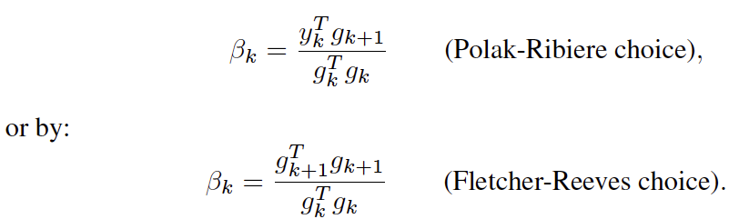
Conjugate gradient: construction of the directions
Define y_{k}=g_{k+1}-g_{k}
The first search direction p₁ is given by the negative gradient -g₁ . The sequence x_{k} of approximations to the minimizer is defined by:
g_{k} is the gradient, α_{k} is chosen to minimize E along the p_{k} and βk is given by:

Slide 36

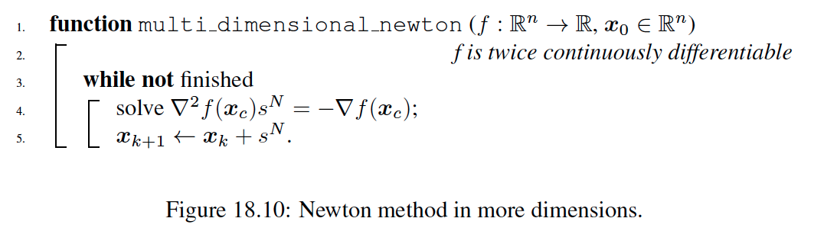
Nonlinear optimization in more dimensions
Newton’s method in more dimensions consists of solving the quadratic model

Slide 37
Newton’s method in higher dimensions: possible problems
Conditions for convergence:
initial point is close to the minimizer x,
Hessian is positive definite at the minimizer
Problems if the Hessian is not positive definite, singular or ill-conditioned
Modified Newton’s methods change the local model to obtain a sufficiently positive-definite and non-singular matrix.
Combine a fast tactical local method with a robust strategic method to assure global convergence

Slide 38

Global convergence through line searches
Global convergence is obtained by adopting line searches along the identified direction
if H is positive definite, Newton’s direction is a descent direction
How do we ensure global convergence? f value must decrease by a sufficient amount w.r.t the step length step must be long enough search direction must remain not orthogonal to the gradient

Slide 39
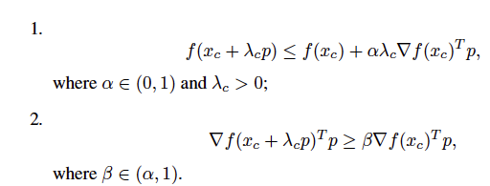
Global convergence through line searches(2)
In order to guarantee the above points we can resort to Armijo and Goldstein conditions

Slide 40


Global convergence through line searches(3)
If the Armijo-Goldstein conditions are satisfied at each iteration and if the error is bounded below, one has the following global convergence property:
provided that each step is away from orthogonality to the gradient:
If the Armijo-Goldstein conditions are maintained, one-dimensional searches lead to global convergence

Slide 41
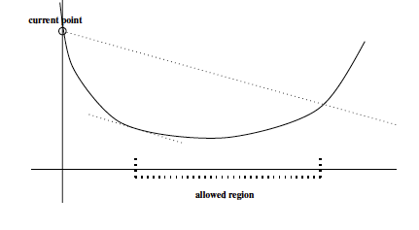
Visualization of Armijo - Goldstein conditions.

Slide 42

Cure for indefinite Hessians
If the Hessian is indefinite one can use the modified Cholesky method
It consists in adding to H a simple diagonal matrix:
and performing a Cholesky decomposition on the modified Hessian
This amounts to adding a positive definite quadratic form to our original model.
2

Slide 43
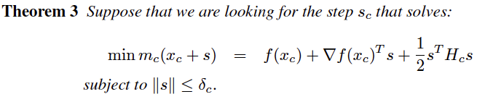
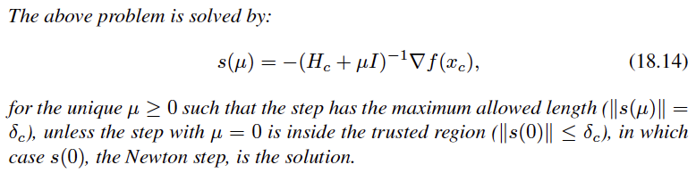
Relations with model-trust region methods
In model-trust region methods the model is trusted only within a region, that is updated by using the experience accumulated during the search process.

Slide 44
Relations with model-trust region methods(2)
The diagonal modification of the Hessian is a compromise between gradient descent and Newton’s method :
μ tends to zero the step tends to coincide with Newton’s step,
μ is large the step tends to be proportional to the negative gradient:

Slide 45



Secant methods in higher dimension
Secant techniques are useful if the Hessian is not available or costly to calculate.
Let the current and next point be x_{c} and x₊ , respectively, and let’s define s_{c} = x₊ - x_{c} and
The analogous “secant equation” is

Slide 46
Secant methods in higher dimension
The above equation does not determine a unique H₊ but leaves the freedom to choose from a (n² - n) dimensional affine subspace
The equation will not be used to determine but to update a previously available approximation
One can find the matrix in Q(s_{c}, y_{c}) that is closest to the previously available matrix

Slide 47

Secant methods in higher dimension: Broyden’s update
The resulting Broyden’s update is
Warning: it may be not symmetric, but
Iterating Broyden projection and a projection onto the subspace of symmetric matrixes one obtains a sequence of matrixes converging to a solution that is both in Q(s_{c}, y_{c}) and symmetric!

Slide 48


Secant methods in higher dimension: Powell’s update
The symmetric secant update of Powell is given by a composition of Broyden’s update and a projection onto the subspace of the symmetric matrixes
For the update to be also positive definite we can resort to the Broyden, Fletcher, Goldfarb, and Shanno (BFGS) update, that reads

Slide 49
Second-order methods with linear complexity
Complexity:
-Computing the exact Hessian: O(n²) operations, O(n²) memory -Determining the search direction: O(n³) operations
computation and memory requirements to find the search direction can be reduced to O(n): calculate some second-order information by starting from the last gradients.

Slide 50


One-step method
The one-step method requires only vectors computed from gradients. The new search direction p₊ is obtained as:
Where
s_{c}, g_{c} and y_{c} are respectively last step, gradient and difference of gradients.

Slide 51
One-step method
The one-step method requires only vectors computed from gradients. The new search direction p₊ is obtained as:
Where
s_{c}, g_{c} and y_{c} are respectively last step, gradient and difference of gradients.

Slide 52
Derivative-free techniques: the Reactive Affine Shaker (RAS)
Partial derivative may not be computable in some cases (the function may not be differentiable, or the computation may be too hard)
In this case, we use optimization methods based only on the knowledge of function values

Slide 53
Adaptive random search: general scheme
Choose an initial point in the configuration space and an initial search region surrounding it and repeat:
Generate a new candidate point sampling the search region according to a given probability measure
If the value of the function at the new point is is greater then the current (failure to improve), compress the search region, otherwise expand it
If the sample is successful the new point becomes the current point, and the search region is moved so that the current point is at its center

Slide 54
RAS: adaptation of the sampling region
Reactive Affine Shaker (RAS): self-adaptive and derivative-free optimization method
Main design criterion: adaptation of a search region by an affine transformation
The modification takes into account the local knowledge derived from trial points generated with a uniform probability in the search region.

Slide 55
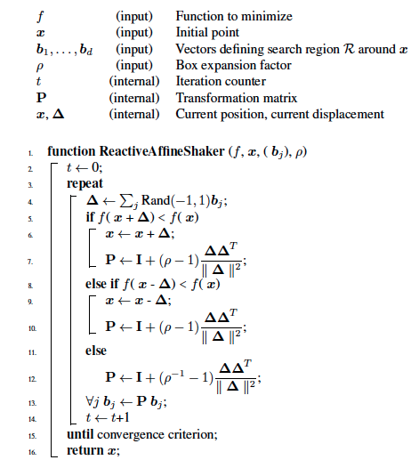
RAS algorithm pseudo-code

Slide 56
RAS algorithm pseudo-code, comments
Testing the function improvement on both x+Δ and x-Δ is called double-shot strategy
It drastically reduces the probability of generating two consecutive unsuccessful samples
If the double-shot strategy fails, then the transformation is applied by replacing the expansion factor ρ with its inverse ρ⁻¹
the search speed is increased when steps are successful, reduced only if no better point is found after the double shot

Slide 57
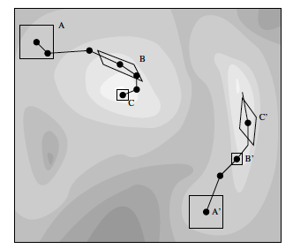
Reactive affine shaker geometry
Reactive Affine Shaker geometry: two search trajectories leading to
two different local minima

Slide 58
Repetitions for robustness and diversification
RAS searches for local minimizers and is stopped as soon as one is found
Even when a local minimum is found, it is generally impossible to determine whether it is global or not
A simple way to continue the search is to restart from a different initial random point

Slide 59
The Inertial Shaker
RAS requires matrix-vector multiplications to update the search region: it is slow if the number of dimensions is large
Solution: Inertial shaker:
the search box is always identified by vectors parallel to the coordinate axes
a trend direction is identified by averaging a number of previous displacements

Slide 60
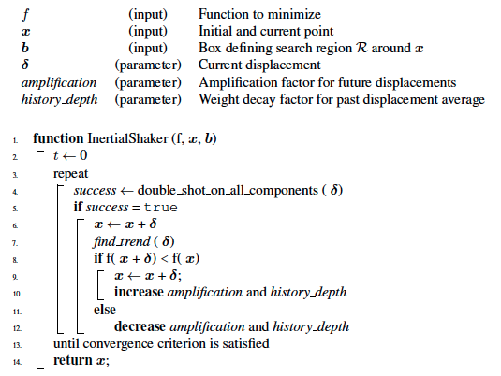
Inertial Shaker, pseudo-code

Slide 61
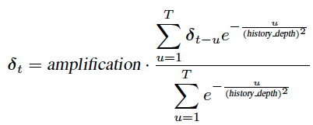
Inertial Shaker, comments on the pseudo-code
find trend returns a weighted average of the m_{disp} previous displacements
amplification and history depth are defined in the algorithm
m_{disp} is chosen in order to cut off negligible exponential weights and to keep the past history reasonably small.

Slide 62
GIST
The purpose of optimization is to design automated techniques to identify inputs leading to maximum (or minimum) output values .
Basic idea: Start from an initial value, apply small local changes to the inputs, test their effects. Decide whether to accept the local change or not.
Repeat until there is progress, leading to better and better output values.

Slide 63
GIST (2)
If derivatives are available, one can predict the effect of small local changes
If derivatives are not available, one can test small changes directly (RAS) and keep locally adapted models to reduce function evaluations.
Local adaptation occurs by learning from the previous steps of the search .

