Slide 1

Roberto Battiti, Mauro Brunato. The LION Way: Machine Learning plus Intelligent Optimization. LIONlab, University of Trento, Italy,
Apr 2015
http://intelligent-optimization.org/LIONbook
© Roberto Battiti and Mauro Brunato , 2015,
all rights reserved.
Slides can be used and modified for classroom usage,
provided that the attribution (link to book website)
is kept.

Slide 2
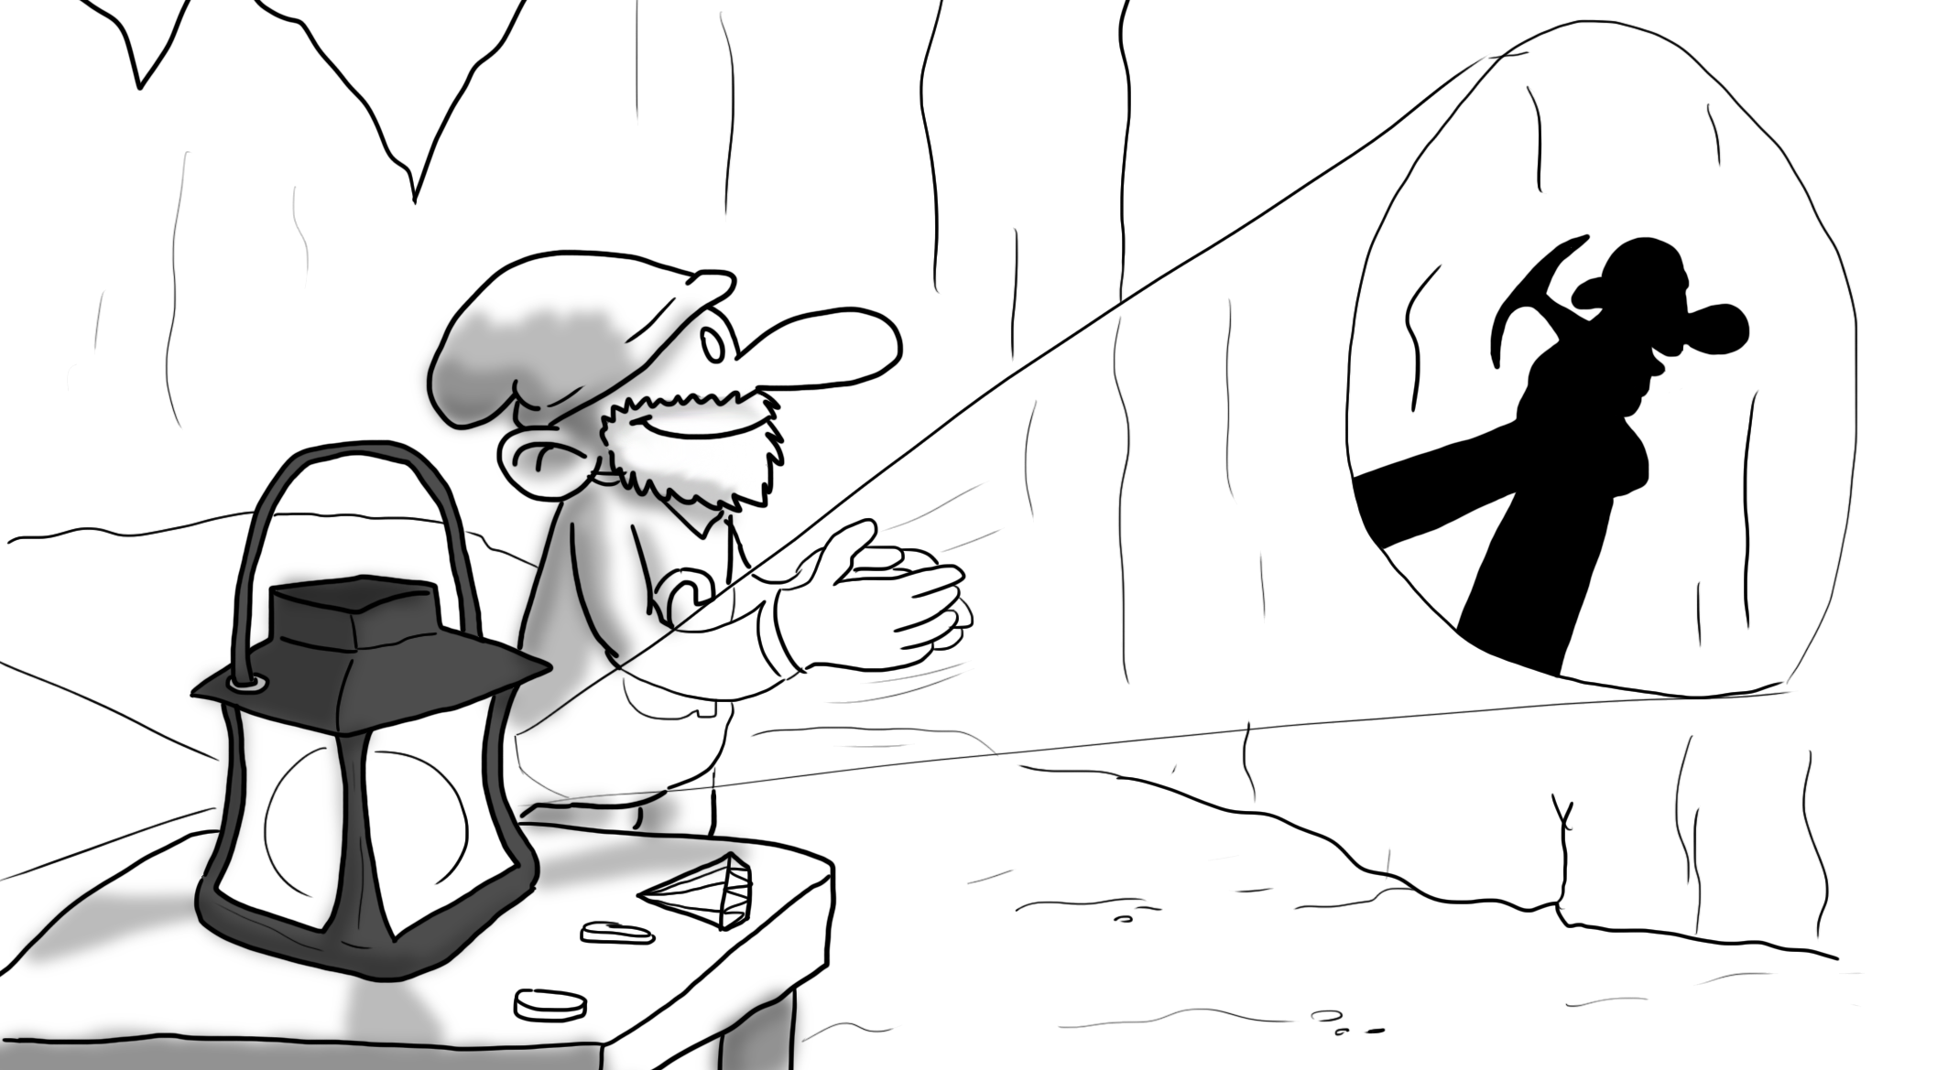
Dimensionality reduction by linear transformations (projections)
You, who are blessed with shade as well as light, you, who are gifted with two eyes, endowed
with a knowledge of perspective, and charmed with the enjoyment of various colors, you, who
can actually see an angle, and contemplate the complete circumference of a Circle in the happy region of the Three Dimensions – how shall I make it clear to you the extreme difficulty which we in Flatland experience in recognizing one another’s configuration?
(Flatland - 1884 -Edwin Abbott Abbott)

Slide 3
Dimensionality reduction
Mapping entities to two or three dimensions helps the visual analysis of the data
The mapping has to preserve most of the information present in the original data.
The objective is to organize entities in two-three dimensions so that similar objects are near to each other and dissimilar objects are far from each other.
In general, reducing dimensions to a smaller number (but greater than 2 o 3) can be very useful for subsequent machine learning steps

Slide 4
How to measure dissimilarity
Dissimilarity measures can be explicitly given for any pair of entities (external dissimilarity) or can be derived from an internal representation of the entities (i.e. from their coordinates) from a distance metric.
In some cases the information given to the system consists of both coordinates and relationships (think about labeling entities after a clustering is performed)

Slide 5
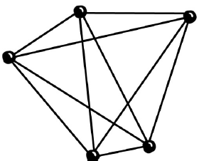
External dissimilarity structure.
N entities, characterized by some mutual dissimilarities δ_{ij} can represented by a graph
Each node represents an entity, and a connection with weight δ_{ij} is present between two nodes, if and only if a distance δ_{ij} is defined for the corresponding entities.

Slide 6
Notation
Assumption: data is centered (the mean of each coordinate is zero), otherwise subtract mean.
n number of vectors (entities)
m dimension of each vector
X n x m matrix storing the entities (one row for each entity: Xiα α-th coordinates of item i)
Latin indices i j range over the data items, while Greek indices α,β range over the coordinates
S is the the m x m biased covariance matrix: S = 1/n X^{T}X

Slide 7
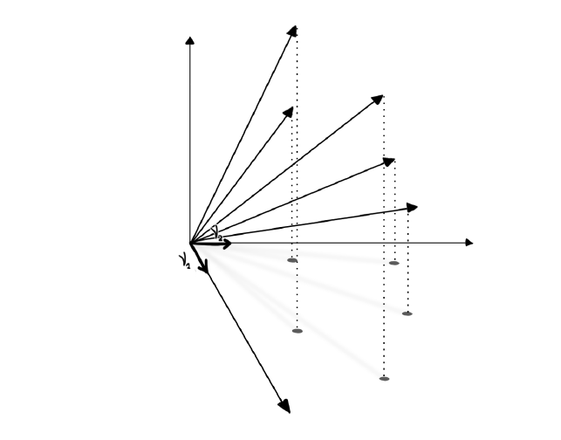
Linear projection
A projection: each dotted line connecting a vector to its projection is perpendicular to the plane defined by ν1 and ν2 (in this case the direction vectors are the X and Y axes, in general a projection can be on any plane identified by two linearly independent vectors).

Slide 8
Linear projection (2)
Linear transformation L of the items to a space of dimension p
L is represented by a p x m matrix, acting on vector x by matrix multiplication y = Lx
The p rows ν¹, …, ν^{p} in R^{m} of L are called direction vectors, and have unit norm
Each coordinate in the transformed p-dimensional space is obtained by projecting the original vector x onto ν^{α} .
The coordinate vectors are given by x¹ = Xν¹ ,…, x^{p} = Xν^{p}.

Slide 9
Orthogonal projections
If the direction vectors ν¹, …, ν^{p} are mutually orthogonal and with unit norm: ν^{i} • ν^{i} =δ_{ij}, we have an orthogonal projection
Example: a selection of a subset of the original coordinates (in this case ν^{i} = (0, 0,…,1,…0))
The visualization is simple because it shows genuine properties of the data
On the contrary, nonlinear transformations may deform the original data distribution in arbitrary and potentially very complex and counter-intuitive ways
Linear projection are efficient both computationally and with respect to storage requirements.

Slide 10


Principal Component Analysis (PCA)
PCA finds the orthogonal projection that maximizes the sum of all squared pairwise distances between the projected data elements.
Let dist_{ij}^{p} be the distance between the projections of two data points i and j
PCA maximizes
Maximize variance,
Spread points as much as possible

Slide 11

Principal Component Analysis (2)
With a projection, distances can only decrease, from Pythagora’s theorem
The objective of PCA is to approximate as much as possible the original sum of squared distances, in a space of smaller dimension, by projection.

Slide 12
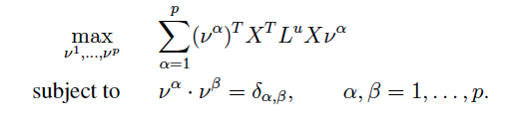
Principal Component Analysis (3)
Define the n x n unit Laplacian matrix L^{u}, as L^{u}_{ij} = (n•δ_{ij} - 1)
(a key tool for describing pairwise relationships )
The optimization problem becomes
The solution is given by the p eigenvectors with largest eigenvalues of the m x m matrix X^{T}L^{u}X

Slide 13
Principal Component Analysis (4)
For centered coordinates, the following holds true: X^{T}L^{u}X = n²S. That is, the matrix is proportional to the covariance matrix, hence:
The solutions for PCA is obtained by finding the eigenvectors of the covariance matrix with largest eigenvalue

Slide 14
Meaning of PCA
PCA transforms a number of possibly correlated variables into a smaller number of uncorrelated variables (principal components).
The first principal component accounts for as much of the variability in the data as possible, and each succeeding component accounts for as much of the remaining variability as possible
PCA minimizes the mean squared error incurred when approximating the data with their projections

Slide 15
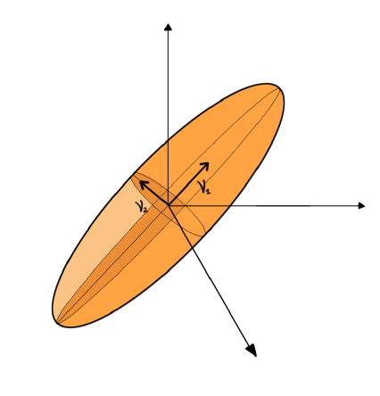
Principal component analysis, data are described by an ellipsoid. The first eigenvector is in the direction of the longest principal axis, the second eigenvector lies in a plane perpendicular to the first one, along the longest axis of the two-dimensional ellipse.

Slide 16
Limitations of PCA
PCA simply performs a coordinate rotation that aligns the transformed axes with the directions of maximum variance.
The computational cost is related to solving the eigenvalues-eigenvectors for a matrix of dimension m x m and is not related to the number of points n, hence it is very fast if the dimension is limited
Limitations:
Having a larger variance is not always related to having a larger information content (it can be a side-effect of the choice of physical units)
PCA is sensitive to outliers (the sum of squared distances in involved in the optimization)
If PCA is used for feature selection for classification, its main limitation is that it makes no use of the class label of the feature vector

Slide 17

Weighted PCA: combining coordinates and relationships
in some cases additional information is available in the form of relationships between (some) entities
extend the PCA approach to incorporate additional information:
minimize a weighted sum of the squared projected distances (d_{ij} represents the weight)

Slide 18

Optimization problem for weighted PCA
we can now assign to the problem an n x n Laplacian matrix L^{d}
The optimal projection are obtained as the direction vectors given by the p highest eigenvectors of the matrix X^{T}L^{d}X.

Slide 19
Tuning dissimilarity values to create variations of PCA
In normalized PCA d_{ij} = 1/disti_{ij} to discount large original distances in the optimization (useful to increase robustness with respect to outliers)
In supervised PCA, with data labeled as belonging to different classes, we can set dissimilarities d_{ij} to a small value if i and j belong to the same class, to a value 1 if they belong to different classes (more important to put at large distances points of different clusters)

Slide 20
Fisher linear discrimination by ratio optimization
Fisher analysis deals with finding a vector ν_{F} such that, when the original vectors are projected onto it, values of the different classes are separated in the best possible way.
A nice separation is obtained when the sample means of the projected points are as different as possible, when normalized with respect to the average scatter of the projected points.

Slide 21
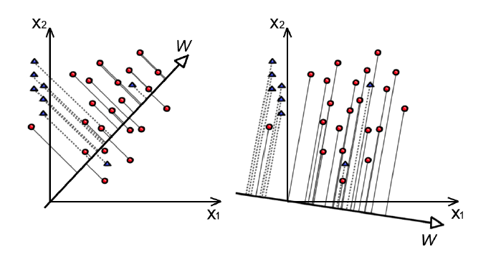
Fisher linear discrimination
Fisher linear discrimination (triangles belong to one class, circles to
another one): the one-dimensional projection on the left mixes projected points
from the two classes, while the projection on the right best separates the projected
sample means w.r.t. the projected scatter.

Slide 22
Fisher linear discriminant: formal definition
Let n_{i} be the number of points in the i-th cluster, let μ_{i} and S_{i} be the mean vector and the biased covariance matrix for the i-th cluster
The matrix is the average within-cluster covariance matrix
and is the average between cluster covariance matrix.

Slide 23

Fisher linear discriminant: formal definition (2)
Fisher linear discriminant is defined as the linear function y = ν^{T}x for which the following ratio is maximized:
We want to maximally separate the clusters (the role of the numerator where the projections of the means count) and keep the clusters as compact as possible (the role of the denominator).

Slide 24



Fisher linear discriminant for 2 classes
For the special case of two classes, the Fisher linear discriminant is the linear function y = w^{T}x for which the following criterion function is maximized:
where m_{i} is the sample mean for the projected points
s² is the scatter of the projected samples of each class

Slide 25


Fisher linear discriminant for 2 classes (2)
The solution is:
where m_{i} is the d-dimensional sample mean for class i and S_{w} is the sum of the two scatter matrices S_{i} defined as follows

Slide 26
Fisher discrimination index for selecting features
Two-way classification problem with input vectors of d dimensions
Rate the importance of feature i according to the magnitude of the i-th component of the Fisher vector w_{F}
The largest components in Fisher vector will heuristically identify the most relevant coordinates for separating the classes
Rationale: if the direction of a coordinate vector is similar to the direction of the Fisher vector, we can use that coordinate to separate the two classes
Drawbacks: inverting the matrix can be computationally demanding and this measure can be insufficient to order many features

Slide 27
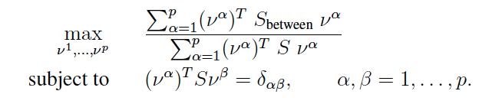
Fisher’s linear discriminant analysis (LDA)
LDA: find p different projection direction instead of just one, maximizing the following ratio:

Slide 28
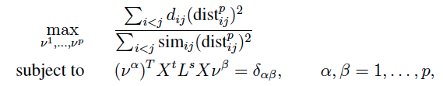

Fisher’s linear discriminant analysis (LDA)(2)
LDA is sensitive to outliers and it does not take the shape and size of clusters into consideration.
This can be taken into account maximizing the following ratio:
where d_{ij} are dissimilarity weights, sim_{ij} are similarity weights and L^{s} is the Laplacian matrix corresponding to the similarities

Slide 29
Conclusions
finding an optimal projection requires defining in measurable ways what is meant by optimality
unsupervised (based only on coordinates) and supervised information (based on relationships), can be combined to give different weights to different preferences for placing items distant or close.
What is left is to derive m x m matrices and to use an efficient and numerically stable way to solve an m x m generalized eigenvector problem

Slide 30
GIST
Visualizations help the human unsupervised learning capabilities to extract knowledge from the data.
They are limited to the two-three dimensions
A simple way to transform data into two-dimensional views is through projections
Orthogonal projections can be intuitively explained as looking at the data from different and distant points of view

Slide 31
GIST(2)
Principal Component Analysis (PCA) identifies the orthogonal projection that spreads the points as much as possible in the projection plane
But keep in mind that having a larger variance is not always related to having the largest information content
If available, relationships can be used to modify PCA (weighted PCA) and obtain more meaningful projections.

Slide 32
GIST(3)
When class labels are present, Fisher discrimination projects data so that the ratio of difference in the projected means of points belonging to different classes divided by the intra-class scatter is maximized.

