Slide 1
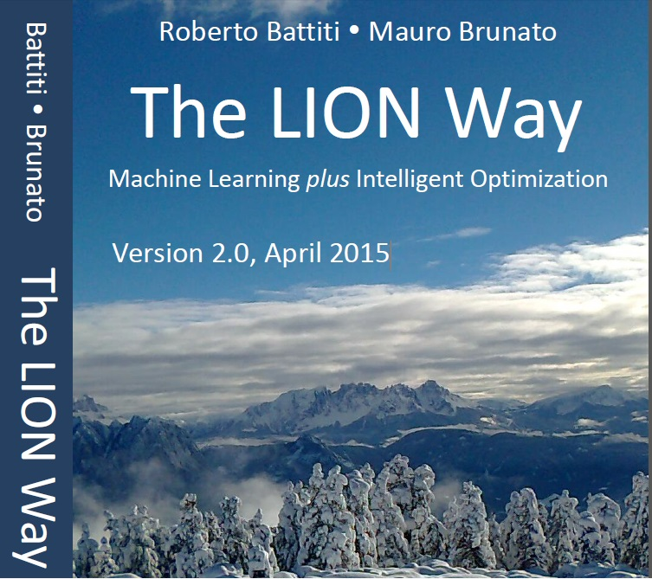
Roberto Battiti, Mauro Brunato.
The LION Way: Machine Learning plus Intelligent Optimization.
LIONlab, University of Trento, Italy,
Apr 2015
http://intelligent-optimization.org/LIONbook
© Roberto Battiti and Mauro Brunato , 2015,
all rights reserved.
Slides can be used and modified for classroom usage,
provided that the attribution (link to book website)
is kept.

Slide 2
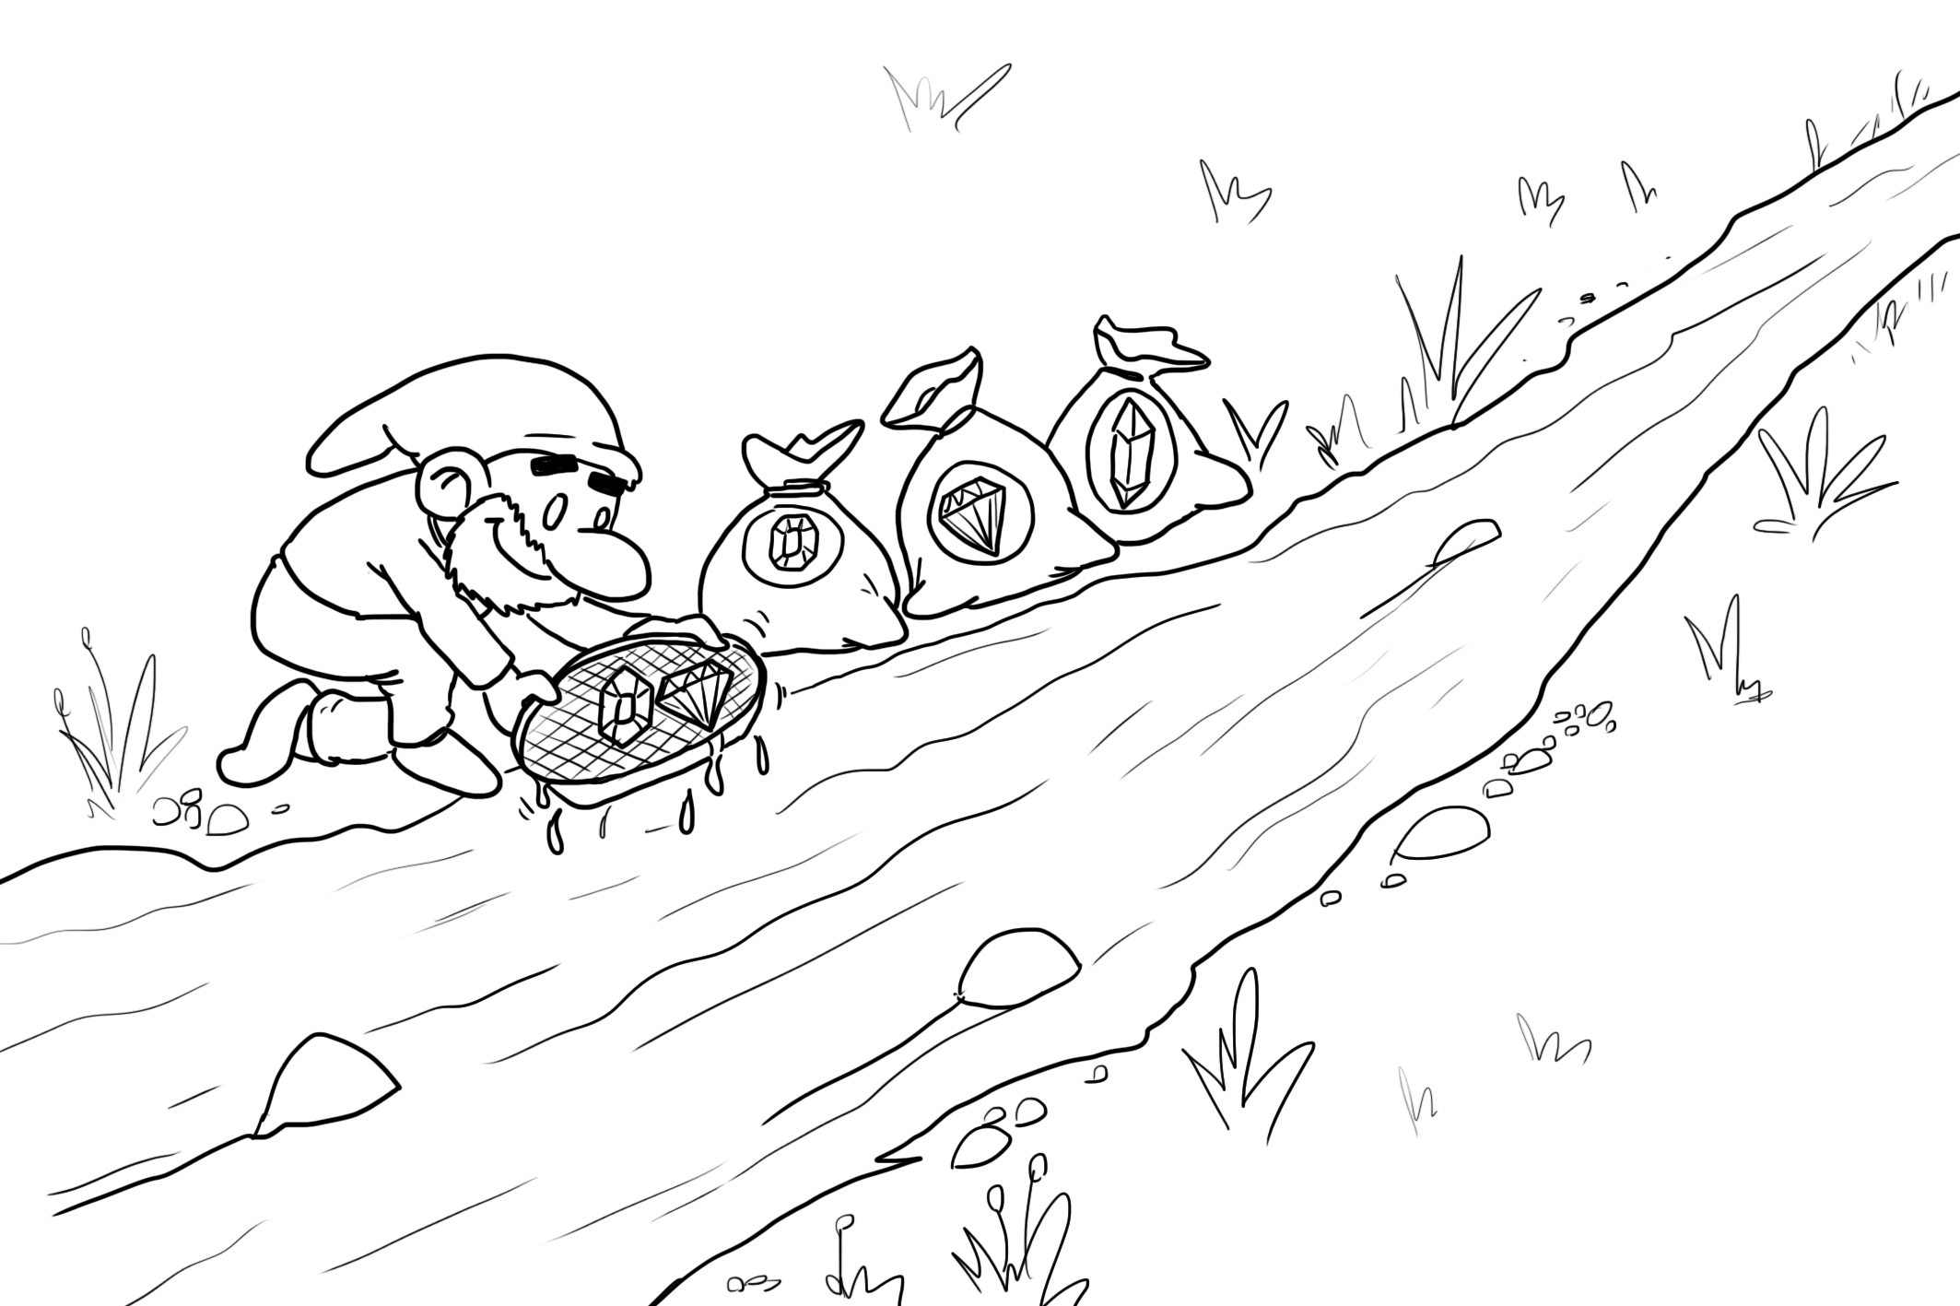
Bottom-up (agglomerative) clustering
Birds of a feather flock together.

Slide 3
Agglomerative clustering: definition
Hierarchical algorithms find successive clusters by merging previously established smaller clusters,
  Begin with each element as a separate cluster.
  At each step the most similar clusters are merged. Note: This requires a measure of similarity between two clusters. (or between a cluster and a single element).

Slide 4
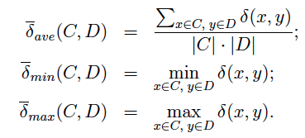
Distance between clusters
A distance between clusters can be derived from a distance between elements
Three main choices:
C,D are two clusters, δ(x,y) is the distance between the elements x and y.

Slide 5

Merging algorithm
Given a set of clusters C, proceed as follows:
Find clusters C and D in C with minimum distance
substitute C and D with their union C U D, and register δ* as the distance for which the specific merging occurred;
until a single cluster containing all entities is obtained

Slide 6
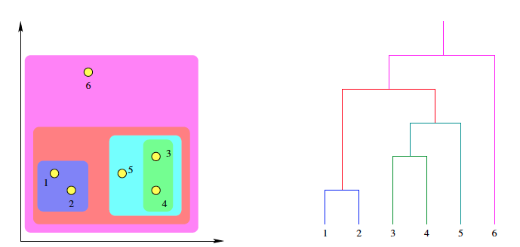
Dendrogram
Hierarchical merging can be visualized through dendrograms, where the original entities are at the bottom and each merging action is represented with a horizontal line connecting the two fused clusters (at a level given by the dissimilarity)

Slide 7

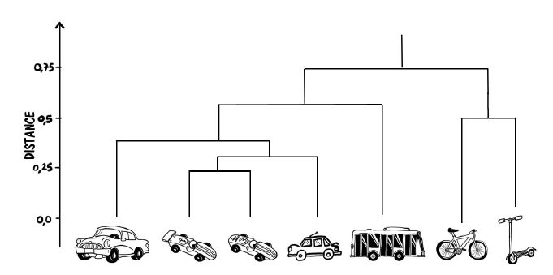
A dendrogram for vehicles

Slide 8
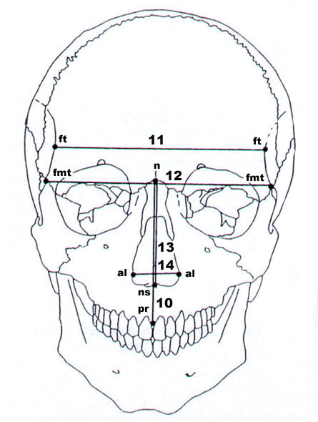
Mahalanobis distance
Prompted by the problem of identifying similarities of skulls
based on measurements in 1927
Given a point x, how do we define the probability for the point to belong to a cluster?
For a symmetric spherical distribution:
Evaluate the standard deviation σ of the distances of the sample points
Evaluate its distance from the average of points (center of mass)
Define the normalized distance |x-μ|/σ
Derive the probability of the test point belonging to the set from the normal distribution

Slide 9
Mahalanobis distance (2)
If the distribution is highly non-spherical the probability of the test point belonging to the set will depend also on the direction of the vector (x- μ)

Slide 10
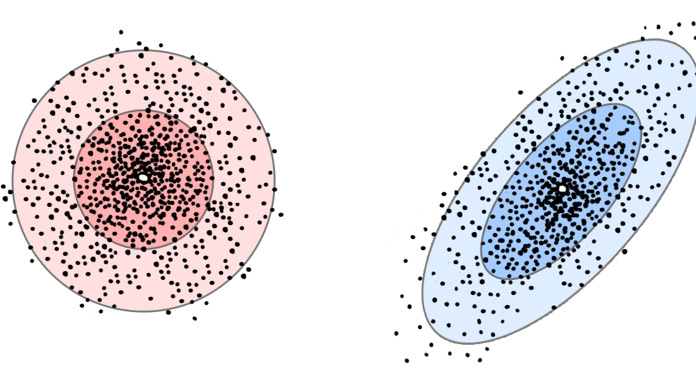
Mahalanobis distance (3)
In the case on the left we can use the Euclidean distance as a dissimilarity
measure, while in the other case we need to refer to the Mahalanobis distance, because
the data are distributed in an ellipsoidal shape.

Slide 11


Mahalanobis distance (4)
The ellipsoid that best represents the set’s probability distribution can be estimated by building the covariance matrix of the samples
The center p of the cluster is the mean value:
Let the covariance matrix components be defined as:

Slide 12

Mahanalobis distance (5)
The Mahalanobis distance of a vector x from a set of values with mean and covariance matrix S is defined as:
It is the distance of the test point from the center of mass divided by the width of the ellipsoid in the direction of the test point

Slide 13
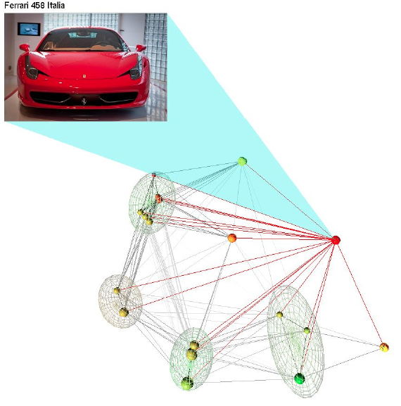
Clustering visualization

Slide 14
Gist
Agglomerative clustering builds a tree (a hierarchical organization) containing bigger and bigger clusters
It is a “bottom up” method: first nearby points are merged, then similar sets are merged, until a single set is obtained.
The number of clusters is not specified at the beginning
a proper number can be obtained by cutting the tree (a.k.a. dendrogram) at an appropriate level of similarity

