Slide 1
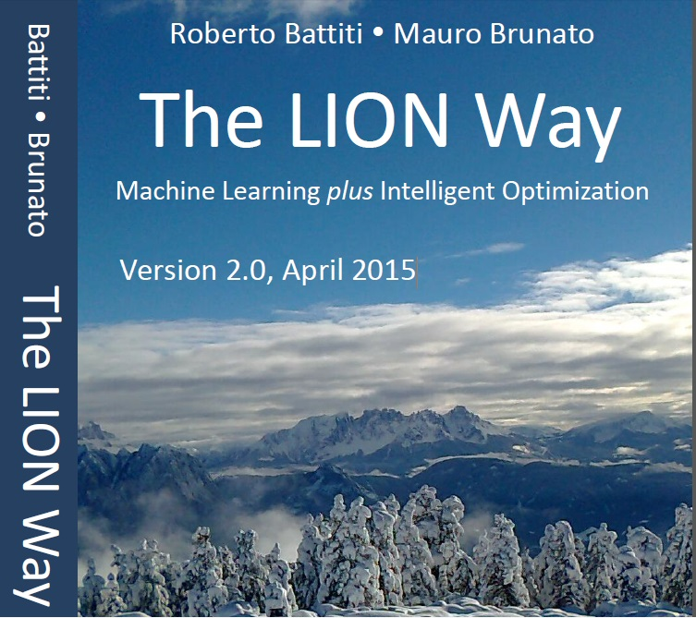
Roberto Battiti, Mauro Brunato. The LION Way: Machine Learning plus Intelligent Optimization. LIONlab, University of Trento, Italy,
Apr 2015
http://intelligent-optimization.org/LIONbook
© Roberto Battiti and Mauro Brunato , 2015,
all rights reserved.
Slides can be used and modified for classroom usage,
provided that the attribution (link to book website)
is kept.

Slide 2
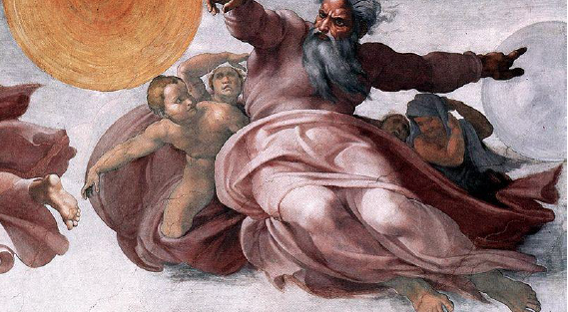
Top-down clustering: K-means
So out of the ground the Lord God formed every beast of the field and every bird of the air, and
brought them to the man to see what he would call them; and whatever the man called every
living creature, that was its name. The man gave names to all cattle, and to the birds of the air,
and to every beast of the field.
(Book of Genesis)

Slide 3
What can be learnt without teachers and labels?
Modeling and understanding structure is at the basis of our cognitive abilities.
A name is a way to group different experiences so that we can start speaking and reasoning (think about animal species, or continent’s names)

Slide 4


An example
Clustering different
flowers in a meadow
without knowing names

Slide 5
Clustering
Clustering: grouping similar things together, then one can label the groups with names.
Compression of information (prototypes)
The prototype summarizes the information contained in the subset of cases which it represents
When similar cases are grouped together, one can reason about groups instead of individual entities.

Slide 6
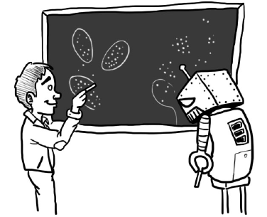
Clustering is deeply rooted into the human activity of grouping and naming entities.

Slide 7
Practical applications
Clustering is used in a wide range of areas like:
Marketing (Market segmentation)
Finance (Risk-analysis of financial portfolios, diversification)
Healthcare (grouping symptoms and defining illnesses, grouping genes in biological networks)
Text mining (construction of semantic networks)

Slide 8
Approaches for unsupervised learning
Top-down:
First the number of classes is decided, then the division is performed.
Bottom-up:
One starts by merging the most similar items and stops when the achieved grouping “makes sense” for the application.

Slide 9
Approaches for unsupervised learning
Dimensionality reduction (identify the “directions of variation” in the data)
Generative models (cluster → a model for a probability distribution of the process producing the observed examples in the cluster)
Semi-supervised learning (use both labeled and unlabeled examples in the learning process)

Slide 10
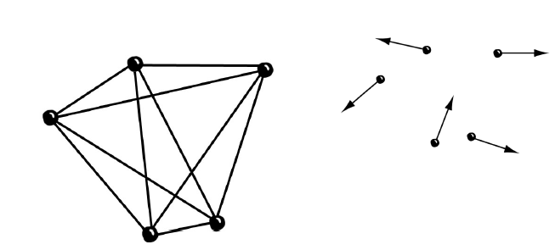
Clustering: Representation and metric
External representation by relationships (left) and internal representation
with coordinates (right). In the first case mutual similarities between pairs are given, in the second case individual vectors.

Slide 11
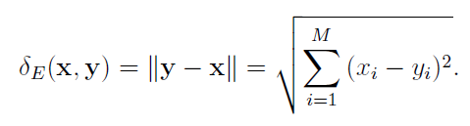
Clustering: Representation and metric (2)
Two different contexts
An internal representation is available for each entity, and mutual similarities are derived from it
Only external representation of dissimilarities is available.

Slide 12
Clustering: Representation and metric (3)
The effectiveness of a clustering method depends on the similarity metric, which is strongly problem-dependent.
Let’s denote the dissimilarity between entities x and y as δ(x, y).

Slide 13
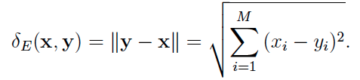


Dissimilarity metrics
If an internal representation is present, a metric can be derived by the usual Euclidean distance:
Or the Manhattan norm:
Or the cosine similarity

Slide 14
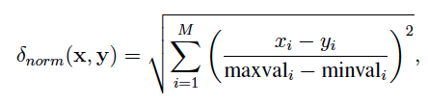
Dissimilarity metrics (2)
If different coordinates have very different ranges, the Euclidean distance may be dominated by a subset of coordinates
This is the case if units of measure are picked in different ways
It cab be useful to normalize values and make them dimensionless, as follows:

Slide 15


K-means for hard and soft clustering
Hard clustering problem: partition the entities D into k disjoint subsets C = (C₁, … ,C_{k}) to reach the following two objectives:
Minimization of the average intra-cluster dissimilarities
Maximization of inter-cluster distance
Clustering is a multi-objective optimization task
or

Slide 16

K-means for hard and soft clustering(2)
Divisive algorithms are very simple clustering algorithms: begin with the whole set and divide it into successively smaller clusters
For each cluster, its prototype is calculated by minimizing the its quantization error:
k-means clustering partitions the observations into k clusters, so that each observation belongs to the cluster with the nearest centroid

Slide 17

K-means: the algorithm
Choose the number of clusters k.
Randomly generate k clusters and determine the cluster centroids pc
Repeat the following steps until some convergence criterion is met
Assign each point x to the nearest cluster centroid
Recompute the new cluster centroid
SIMPLE AND FAST!

Slide 18
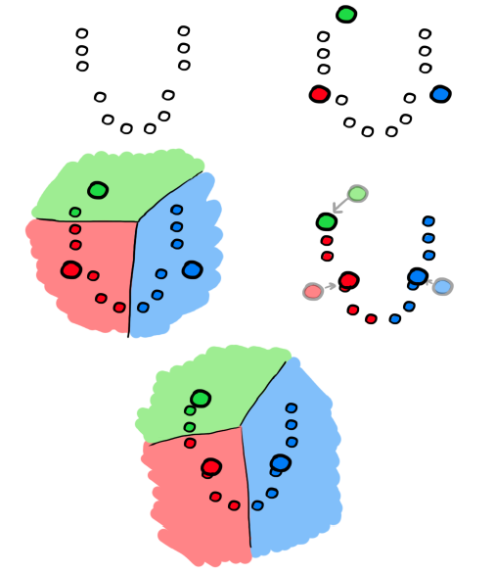
K-means algorithm in action (from top to bottom, left to right). Initial
centroids are placed. Space is subdivided into portions close to the centroids (Voronoi
diagram: each portion contains the points which have the given centroid as closest prototype).
New centroids are calculated. A new space subdivision is obtained.

Slide 19
Voronoi diagrams
Each prototype p_{c} is assigned to a Voronoi cell
A cell for the prototype p_{c} is made of all points closer to pc than to any other prototype
Segments are all the points that are equidistant to the two nearest sites
Voronoi nodes are points equidistant to three (or more) sites

Slide 20

Soft clustering, fuzzy membership
In some cases assignments of entities to clusters are not crisp, but probabilistic or fuzzy
The assignment of each entity is defined in terms of a probability associated with its membership in different clusters, so that values sum up to one (or fuzzy membership if a probabilistic interpretation is not valid)
Cluster membership can be defined as a decreasing function of the dissimilarities:

Slide 21

Soft clustering, centroids update
Online update:
repeatedly consider an entity x, derive its current fuzzy cluster memberships and updates all prototypes so that the closer prototypes tend to become even closer to the entity x:
the prototype is pulled by each entity to move along the vector (x - p_{c})

Slide 22

Soft clustering, centroids update(2)
Batch update:
first sum updated contributions over all entities and then proceed to update, as follows:

Slide 23

Batch vs. online update
When increases, increasingly different results can be obtained
The online update avoids summing all contributions before moving the prototype, and it is therefore suggested when the number of data items becomes very large

Slide 24
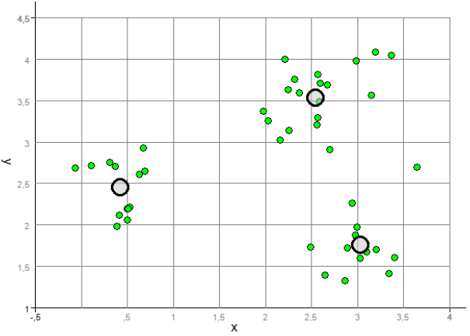
K-means clustering. Individual points and cluster prototypes are shown.

Slide 25
Gist
Unsupervised learning deals with building models by using only input data, without resorting to classification labels.
clustering aims at grouping similar cases in the same group
The information to start the clustering can be given as relationships between couples of points (external representation, prototypes can be computed) or as vectors describing individual points (internal representation)

Slide 26
Gist(2)
Objectives of clustering:
Information compression
Identification of global structure
Reducing cognitive overload by using prototypes
The choice of the similarity metric is key
It is a multi-objective task: similarity within clusters vs. dissimilarity between clusters

Slide 27
Gist(3)
In top-down clustering one proceeds by selecting the desired number of classes and subdividing the cases
K-means starts by positioning K prototypes, assigning cases to their closets prototypes, re-computing the prototypes as averages of the cases assigned to them, ....

